Slide 1
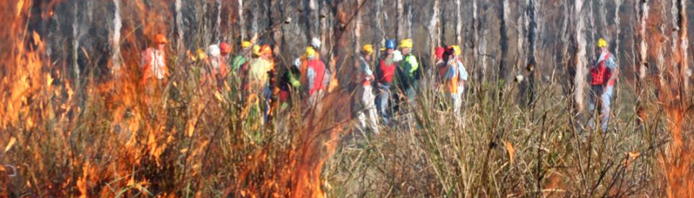
▌What is known and what is unknown
Prof Mike Clarke, LaTrobe University
National Fire Fuels Science Webinar 13 May 2020
The science of hazard reduction: what do we know and what are the knowledge gaps?

Slide 2
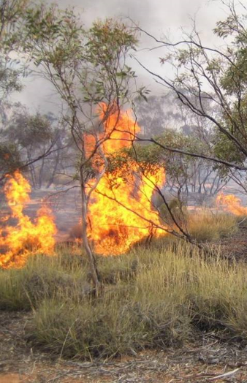
What is known1
Four conditions are needed for large fires to occur (Bradstock 2010):
  Spatially connected plant biomass
  Plant biomass that is dry enough to burn
  An ignition source (lightning or anthropogenic)
  Weather conditions that promote spread (high temp, strong winds, low humidity)
Fuel reduction can reduce the intensity and spread of bushfires and aid suppression efforts when fire conditions are below severe or extreme (e.g. Boer et al. 2009; McCaw et al 2013)
The severity of lethal past megafires is most strongly determined by weather on the day (e.g. Moritz et al. 2004, Carey et al. 2009, Bradstock et al. 2010, Penman et al. 2011).
1. published in the peer-reviewed scientific literature

Slide 3
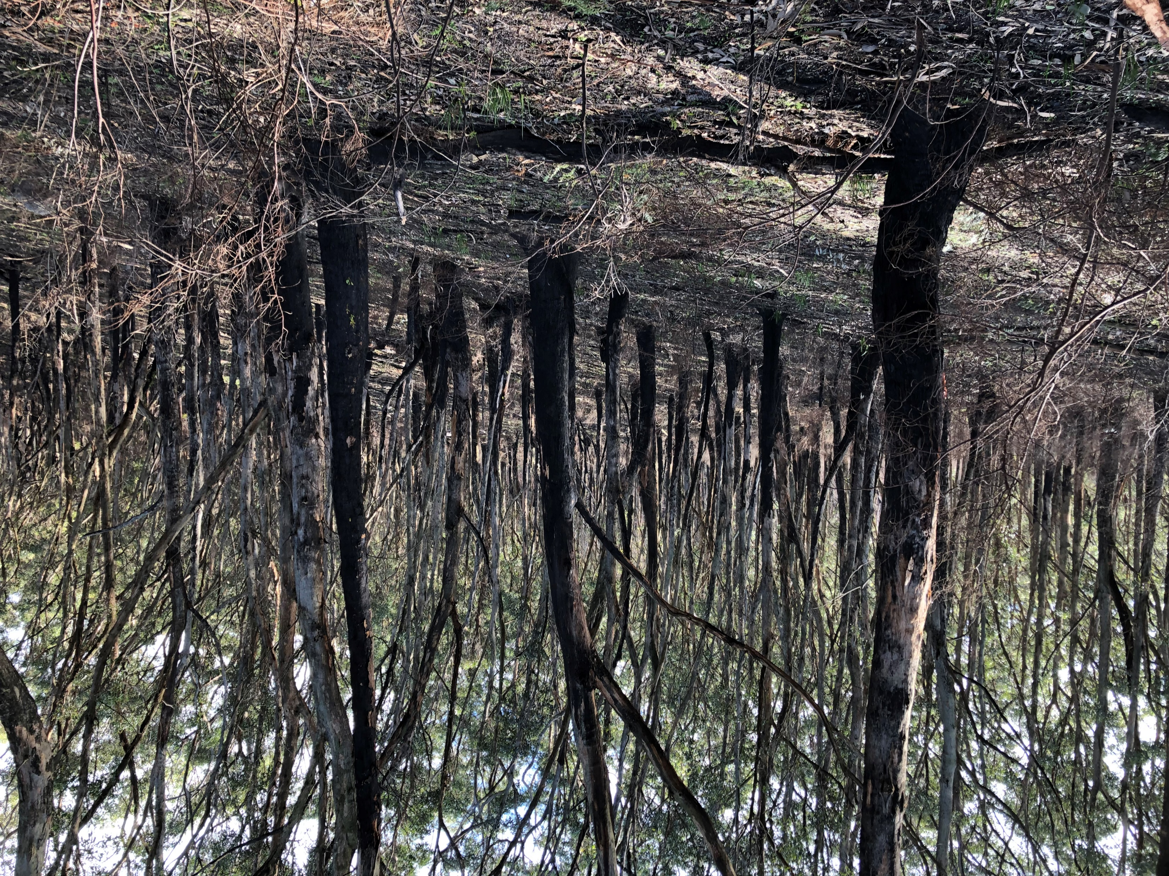
What is known1
Four conditions are needed for large fires to occur (Bradstock 2010):
  Spatially connected plant biomass
  Plant biomass that is dry enough to burn
  An ignition source (lightning or anthropogenic)
  Weather conditions that promote spread (high temp, strong winds, low humidity)
Fuel reduction can reduce the intensity and spread of bushfires and aid suppression efforts when fire conditions are below severe or extreme (e.g. Boer et al. 2009; McCaw et al 2013)
The severity of lethal past megafires was most strongly determined by weather on the day (e.g. Moritz et al. 2004, Carey et al. 2009, Bradstock et al. 2010, Penman et al. 2011).
Fuel reduction close to assets has the greatest impact in reducing loss (Gibbons et al. 2012, Penman et al. 2014)
Fuel reduction burning’s capacity to reduce losses on days of extreme fire weather is modest (~3-5% state-wide according to Vic Forest Fire Management in 2020)
The climate is changing in ways that are increasing fire risk in much of SE Australia:
  More frequent, widespread and longer droughts
  Increase in number of days of extreme fire weather
  Longer fire seasons (starting earlier)
  Fewer days per year suitable for safe fuel reduction burning
    (e.g. Jolly et al. 2015)

Slide 4
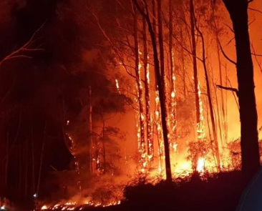
Our primary goal is reducing risk to the things we value
Things we Value
Lives:
Human fatalities
Human health
Assets:
Property, infrastructure, crops, timber, water, carbon
Environment:
Threatened ecosystems
Threatened species
Aesthetic amenity
Risk of large, high severity fires
Direct impact of fire
Premature deaths due to smoke
Fuel reduction burning

Slide 5

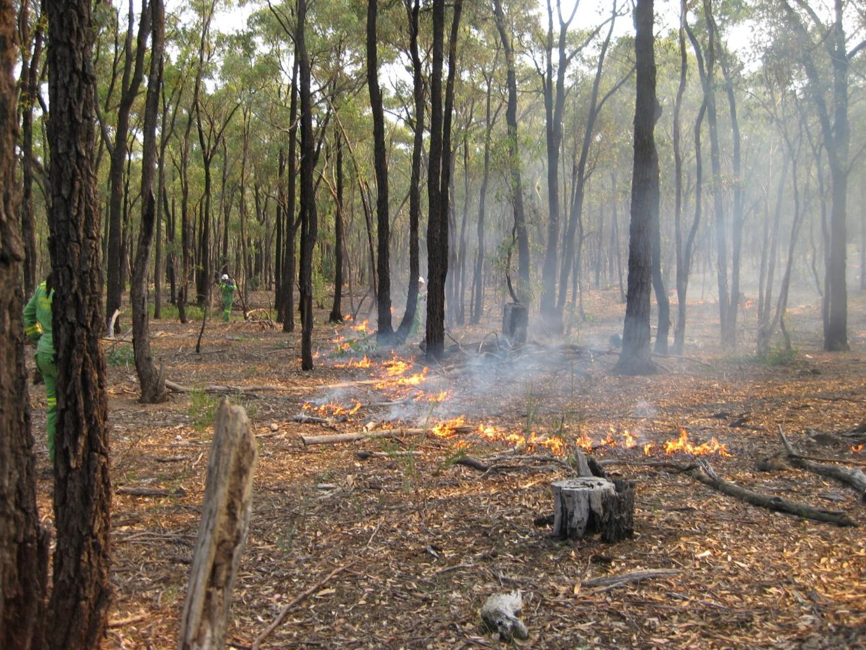
Low severity fires do less ecological damage than high severity fires
Things we Value
Lives:
Human fatalities
Human health
Assets:
Property, infrastructure, crops, timber, water, carbon
Environment:
Threatened ecosystems
Threatened species
Aesthetic amenity
Risk of large, high severity fires
Direct impact of fire
Premature deaths due to smoke
Fuel reduction burning
Some vegetation types require fire, but others don’t.
Can be too hot, frequent or extensive
One size (fire regime) does not fit all

Slide 6
Droughts are causing previously non-combustible plant material to become combustible
Things we Value
Lives:
Human fatalities
Human health
Assets:
Property, infrastructure, crops, timber, water, carbon
Environment:
Threatened ecosystems
Threatened species
Aesthetic amenity
Risk of large, high severity fires
Direct impact of fire
Premature deaths due to smoke
Increasing extent, frequency, duration and severity of droughts
4. Biomass dry enough to burn
3. Ground and near-ground plant biomass
Fuel reduction burning

Slide 7
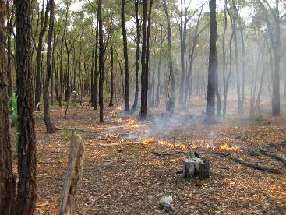
Issues of dispute in scientific literature
1. Days of extreme FFDI
Things we Value
Lives:
Human fatalities
Human health
Assets:
Property, infrastructure, crops, timber, water, carbon
Environment:
Threatened ecosystems
Threatened species
Aesthetic amenity
Risk of large, high severity fires
Direct impact of fire
Premature deaths due to smoke
2. Likelihood of ignitions
Increasing extent, frequency, duration and severity of droughts
4. Biomass dry enough to burn
3. Ground and near-ground plant biomass
1. Efficacy of FRB
Fuel reduction burning

Slide 8
Issues of dispute in scientific literature
1. Days of extreme FFDI
Things we Value
Lives:
Human fatalities
Human health
Assets:
Property, infrastructure, crops, timber, water, carbon
Environment:
Threatened ecosystems
Threatened species
Aesthetic amenity
Risk of large, high severity fires
Direct impact of fire
Premature deaths due to smoke
2. Likelihood of ignitions
Increasing extent, frequency, duration and severity of droughts
4. Biomass dry enough to burn
2. How biomass changes with TSF
3. Ground and near-ground plant biomass
1. Efficacy of FRB
Fuel reduction burning

Slide 9
Issues of dispute in scientific literature
1. Days of extreme FFDI
Things we Value
Lives:
Human fatalities
Human health
Assets:
Property, infrastructure, crops, timber, water, carbon
Environment:
Threatened ecosystems
Threatened species
Aesthetic amenity
Risk of large, high severity fires
Direct impact of fire
Premature deaths due to smoke
2. Likelihood of ignitions
Increasing extent, frequency, duration and severity of droughts
4. Biomass dry enough to burn
3. How the quantity of combustible biomass changes with TSF?
3. Ground and near-ground plant biomass
2. How biomass changes with TSF?
1. Efficacy of FRB
Fuel reduction burning

Slide 10
What is unknown? Where are the knowledge gaps?
4. How does FRB compare with other strategies for reducing risk?
Days of extreme FFDI
3. How effective will FRB be in the context of climate change?
Things we Value
Lives:
Human fatalities
Human health
Assets:
Property, infrastructure, crops, timber, water, carbon
Environment:
Threatened ecosystems
Threatened species
Aesthetic amenity
Risk of large, high severity fires
Direct impact of fire
Premature deaths due to smoke
Likelihood of ignitions
Increasing extent, frequency, duration and severity of droughts
2. How will the distribution of biomass dry enough to burn change under climate change?
Ground and near-ground plant biomass
1. How will a drying climate affect the capacity of ecosystems to recover from fires?
Fuel reduction burning

Slide 12
Accumulated FFDI percentages for spring 2019 compared to the long-term mean for 1950–2018.

Slide 13
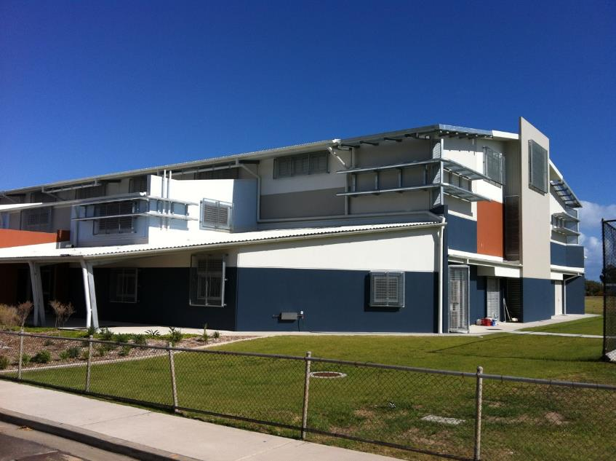
Bowen Qld Cyclone Shelter built by Qld Govt and United Arab Emirates

