Slide 1
▌Litter and fuel: myths miscalculations and misunderstandings
Mark Adams, Swinburne University of Technology
National Fire Fuels Science Webinar 13 May 2020
The science of hazard reduction: what do we know and what are the knowledge gaps?

Slide 2
Background
The role of litter (standing litter, SL) as fuel has been explored for many decades. The basic relationships between mass of fuel and fire intensity and spread are well known.
The mass of standing litter at any one point in time or place, is the balance between rates of input from aboveground litterfall (LF) and rates of litter decomposition (LD).
It is immediately obvious that different components of LF decompose at different rates:
Large logs can persist on the forest floor for decades, even centuries
Leaf litter decomposes relatively quickly, and has a half-life measured in years
In between these extremes, there is very large variation in rates of LD
The fire science community often pay cursory attention to either LF or LD, with a consequence that there are persistent myths, miscalculations and misunderstandings about SL and fuel loads

Slide 3
Myths, miscalculations and misunderstandings
Myth:
fuel loads accumulate for a few years after the last fire (time since fire, TSF) and then remain constant (assumed equilibrium).
Miscalculation:
Based on assumption of achieving equilibrium (LF inputs=LD outputs) within a few years, or even 10 years since fire, fuel loads can be reliably predicted.
Misunderstanding
Because the fire science community has defined fuels according to their combustion (e.g. 1 hour fuel = fine fuel = leaves + twigs = fuel load best related to fire spread), a good many studies are then based on sampling and quantifying only this part of the overall fuel load. As TSF increases, the 1-hour fuels become an ever-decreasing component of overall fuel load.

Slide 4
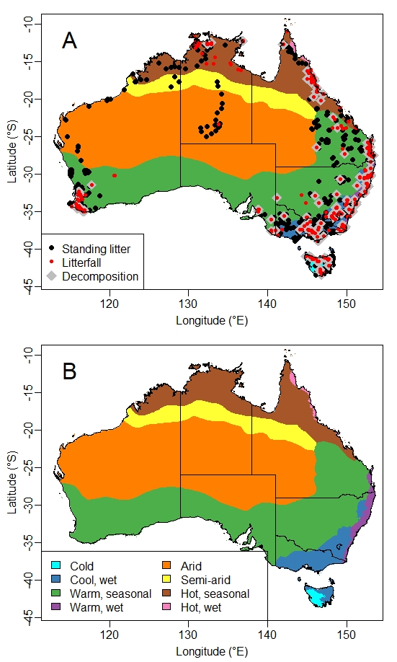
Distribution of litterfall (L) and standing litter (SL) data for Australia in relation to bioclimate zones
Note the prevalence of data for:
Warm and Hot, seasonal climates
Cool wet climates

Slide 5
Mean and standard deviation for litterfall and and standing litter in Australian climatic zones.
Climatic zones | n | Mean litterfall | SD litterfall | n | Mean standing litter | SD standing litter
Cold | 28 | 459 | 131 | 61 | 2334 | 2459
Cool, wet | 475 | 423 | 188 | 1096 | 1295 | 985
Warm, seasonal | 322 | 319 | 202 | 1257 | 1072 | 913
Warm, wet | 257 | 615 | 218 | 710 | 1182 | 829
Arid | 1 | 30 | - | 63 | 157 | 175
Semi-arid | 0 | - | - | 12 | 111 | 140
Hot, seasonal | 172 | 555 | 282 | 275 | 508 | 638
Hot, wet | 52 | 855 | 233 | 30 | 906 | 691
Note:
For standing litter, mean ~ standard deviation.
For litterfall, mean >> standard deviation

Slide 6
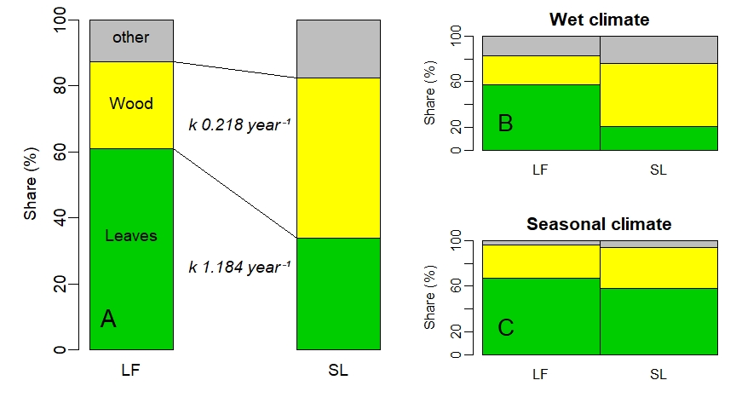
Effects of differences in rates of decomposition on composition of standing litter for Australian forests (A) and for wet climate forests (B) and warm and hot seasonal climate forests (C).

Slide 7
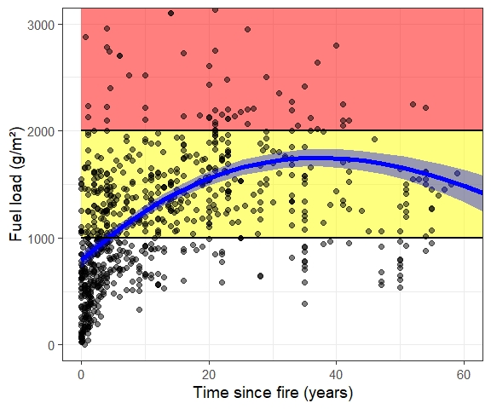
Standing litter contributions to fuel load in forested areas affected by 2019/20 fires in NSW/Vic/ACT. The data shown do not include any woody fuels > 26mm diameter, so are underestimates of total fuels.
Note:
No evidence of fuel loads reaching equilibrium within 40 years of previous fire.
Only when the previous fire was <5 years was fire intensity likely to be at an intensity where bit could be fought with hand tools.
For most of the area, fuel loads were approaching the limit of fire suppression by any means

Slide 8
What should be done about it?
Recognize that the myths, miscalculations and misunderstandings are dangerous
Fully characterized SL (by components) in long unburnt forests (e.g. 50 years+ since fire) are essential calibrations of predictive models of fuel loads. Such calibrations should be required for all predictive fuel models (and are almost NEVER applied).
Short-cut sampling of fuel loads – focusing on leaf litter and twigs (with other fuels ignored or discarded) – perpetuates myths and biases data and databases.
Definitions such as those related to consumption during fire (e.g. 1-hour fuels) should be handled with great care. In every fire, fuels that are not completely combusted within a fixed time still contribute (and often strongly) to fire intensity and spread.
Fire science community need to pay a great deal more attention to the LF and LD ‘drivers’ of SL and fuel load. In particular the role of local climate as a key determinant of both LF and LD.
Discard simplistic slogans about fuels being “well understood”. As any rigorous analysis shows, fuel loads display extreme spatio-temporal variation. 100%+ variation in SL at scales of m² to hectares to hundreds of hectares is not only common, it is unremarkable. Until such time as we can reliably predict SL at these scales, fuels will remain a poorly understood but critical driver of fire intensity and spread

