Slide 1
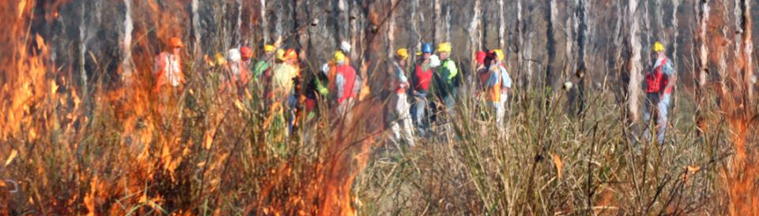
▌Take out the stuff that burns
A/Prof Philip Zylstra, Curtin University
National Fire Fuels Science Webinar 13 May 2020
The science of hazard reduction: what do we know and what are the knowledge gaps?

Slide 2
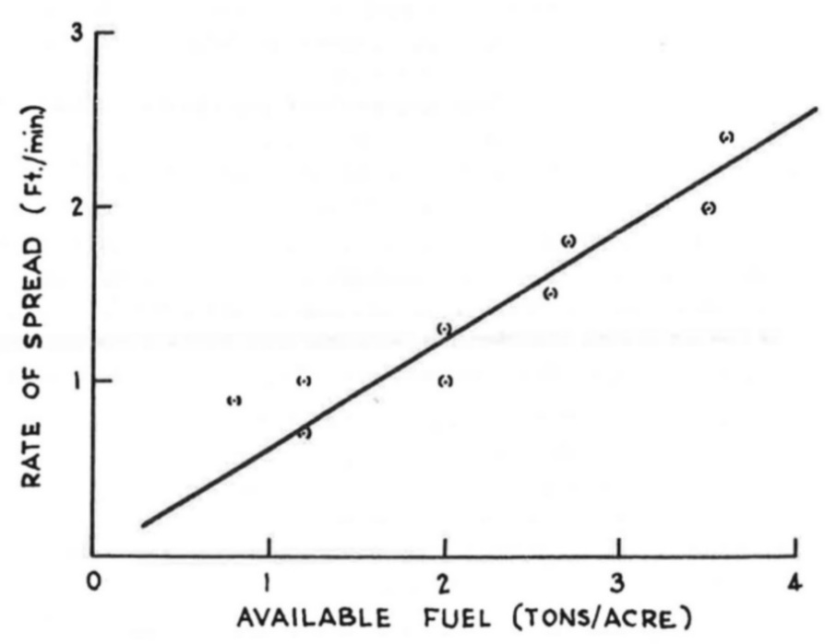
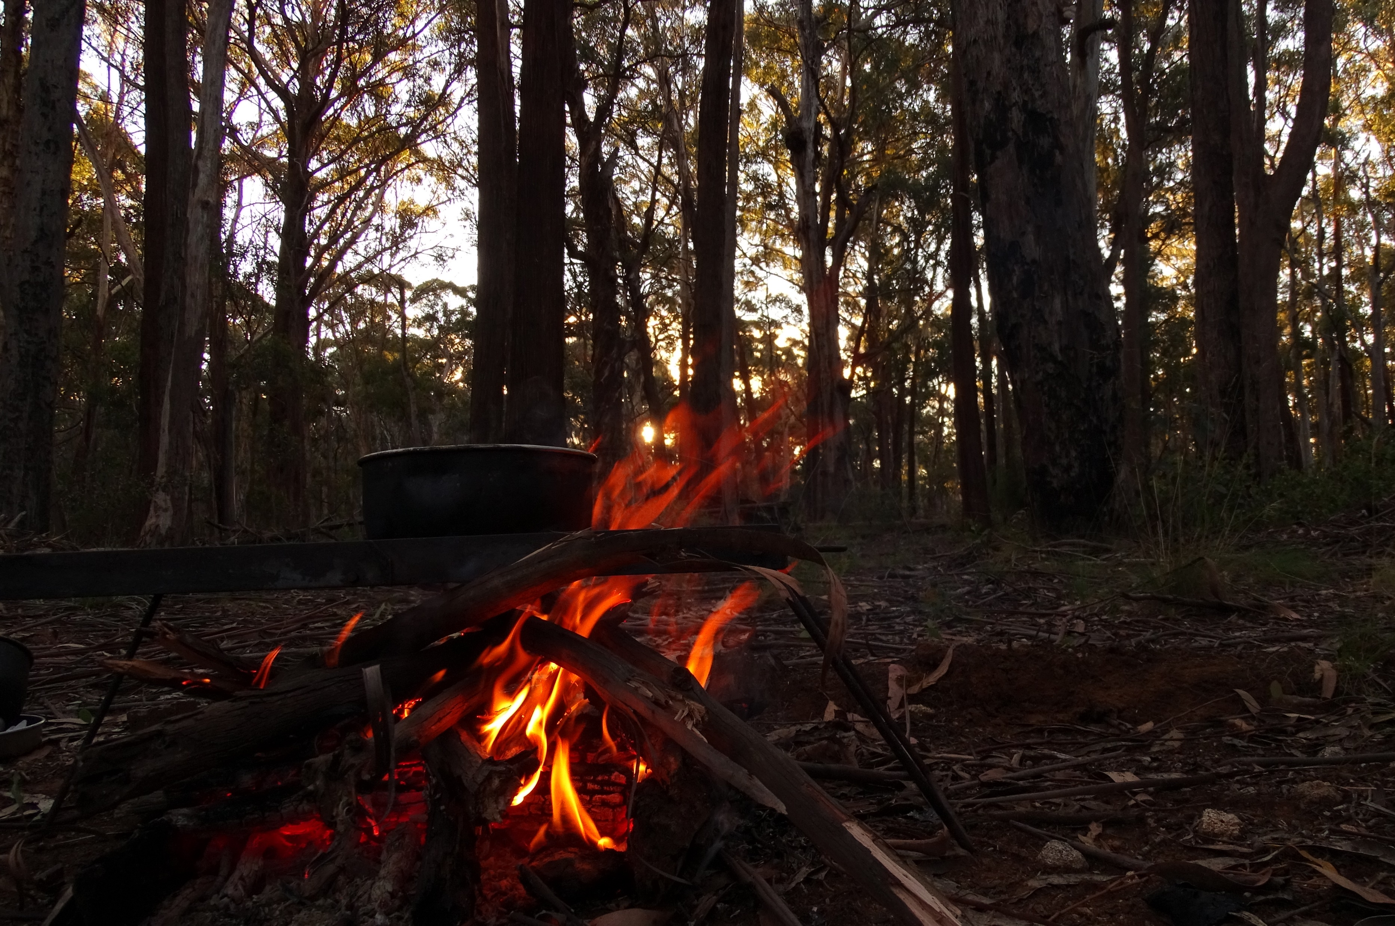
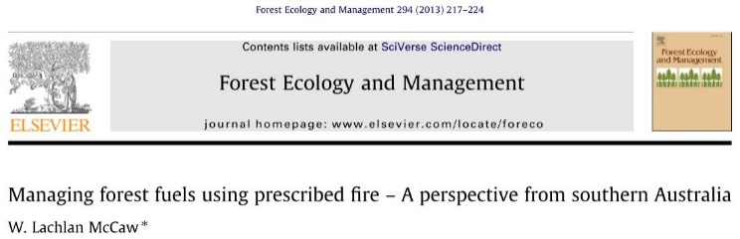
There’s only one way to make bushfires less powerful: take out the stuff that burns
The Conversation, January 6 2020
“This relationship between fuel load, rate of spread and fire intensity has provided a simple but powerful argument to support fuel reduction burning in eucalypt forests for more than 50 years.”

Slide 3
There’s only one way to make bushfires less powerful: take out the stuff that burns
The Conversation, January 6 2020
“Forward rate of spread was therefore found to be independent of the quantity of fuel per unit area.”
“The lack of a relationship between headfire rate of spread and litter fuel quantity reported in this study contrasts with widely held beliefs in the Australian fire community and with commonly used Australian forest fire behaviour guides which assume that spread rate is directly proportional to fuel quantity.”
Dr Neil Burrows, CALMScience 1999
“…many of my observations and comments are tentative and may be proved wrong or subject to drastic change as more data becomes available.”
McArthur AG. Notes on fire behaviour in eucalypt forests. Canberra, ACT; 1966

Slide 4
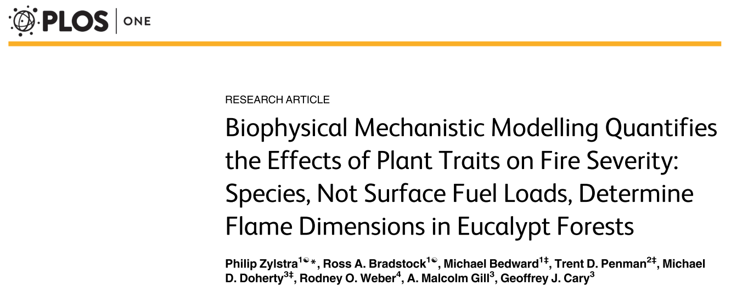
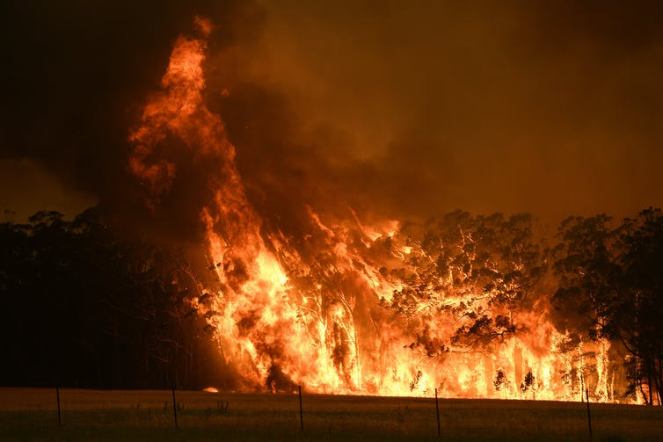
There’s only one way to make bushfires less powerful: take out the stuff that burns
The Conversation, January 6 2020

Slide 5
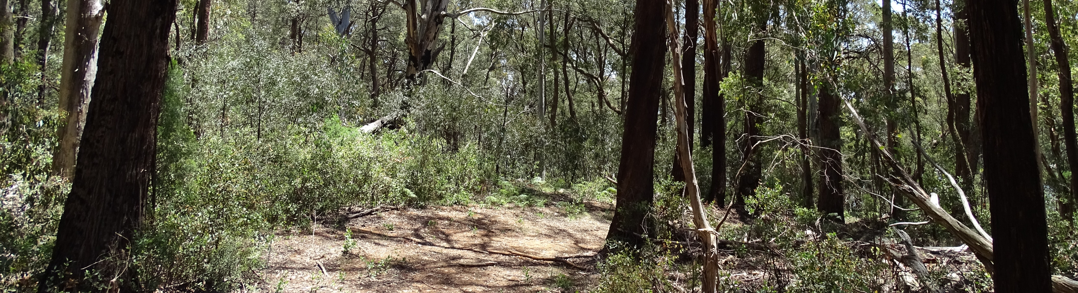
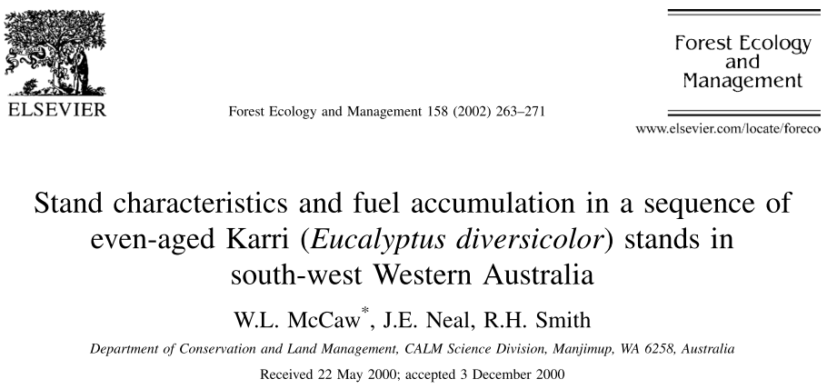
Alpine ash forest
12 years
since prescribed burn
38 years
since fire
Karri forest

Slide 6
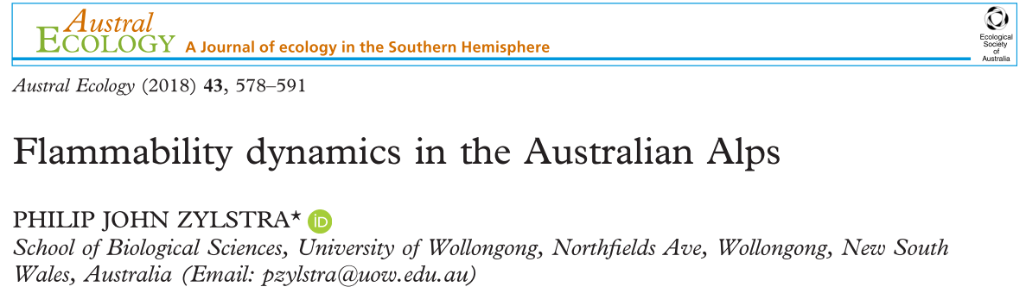
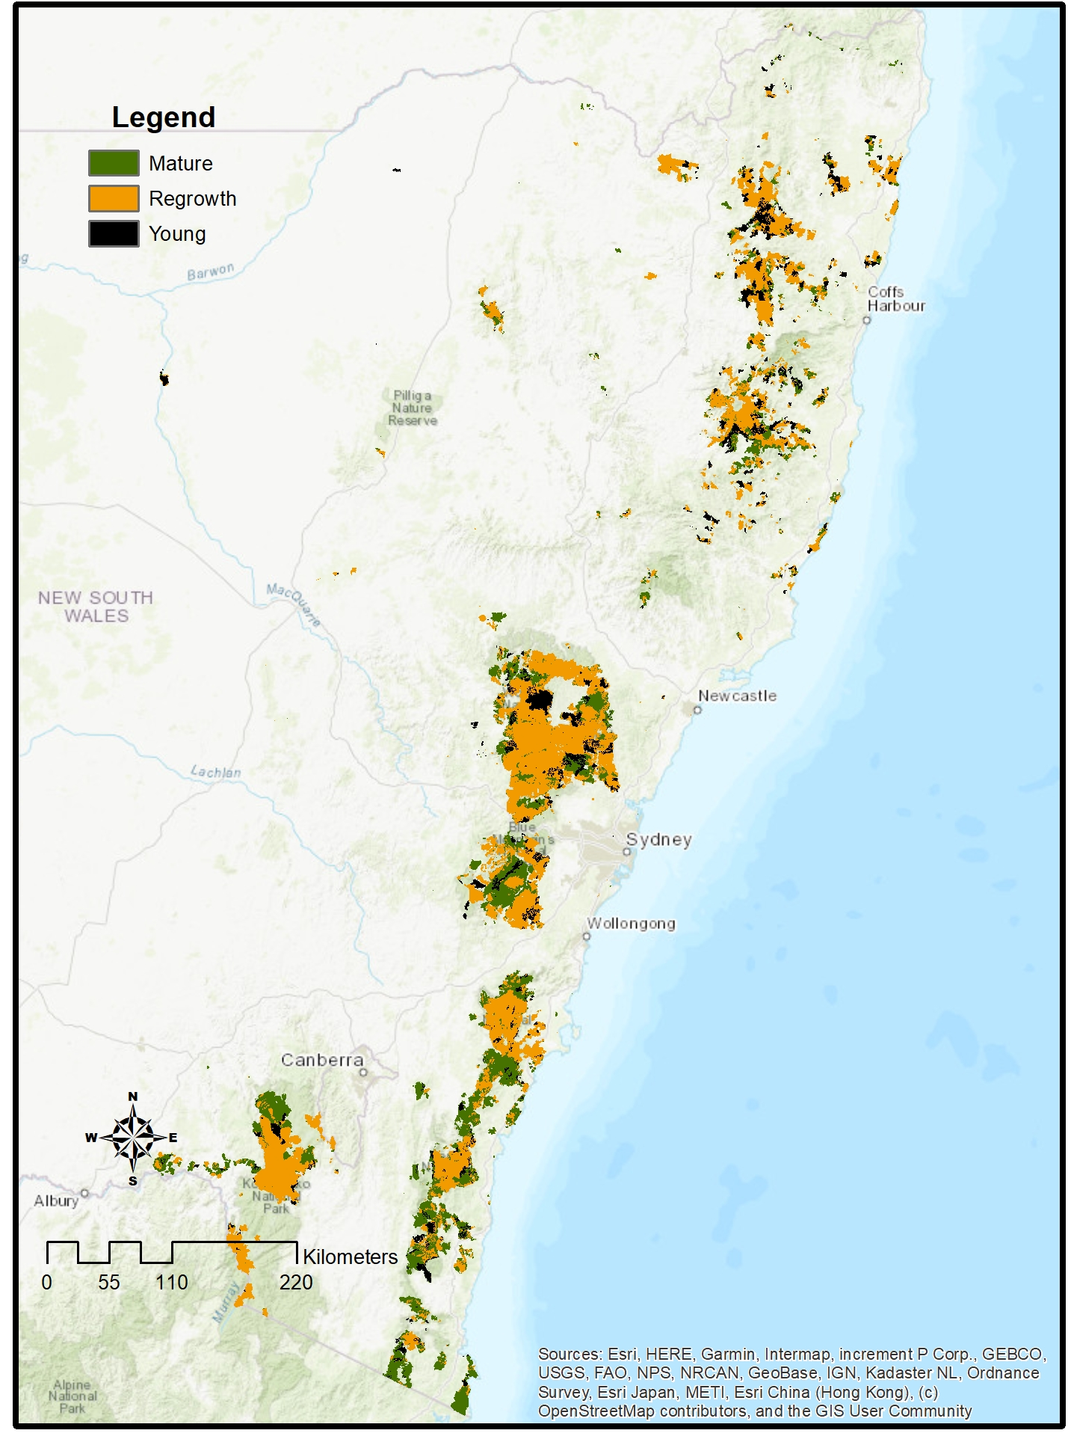

Slide 7
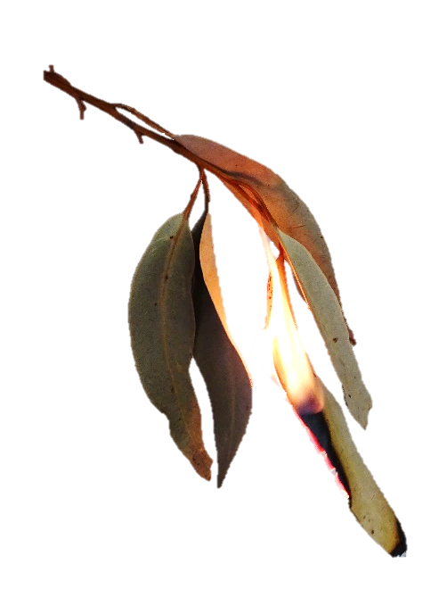

Things should be as simple as possible,
But not simpler.
A/Prof. Philip Zylstra
philip.zylstra@curtin.edu.au

