Slide 1
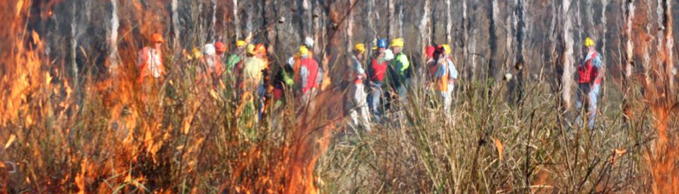
▌Fuels management from a house’s perspective: local vs broad landscape
Justin Leonard (CSIRO)
National Fire Fuels Science Webinar 6 May 2020
The thing about hazard reduction: why is it so difficult and divisive?

Slide 2
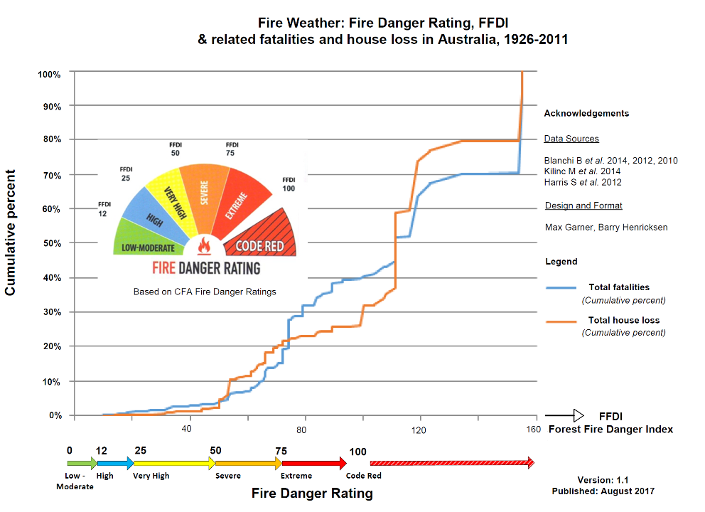

Slide 3
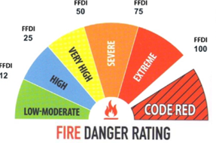
Life Loss & Weather

Slide 4
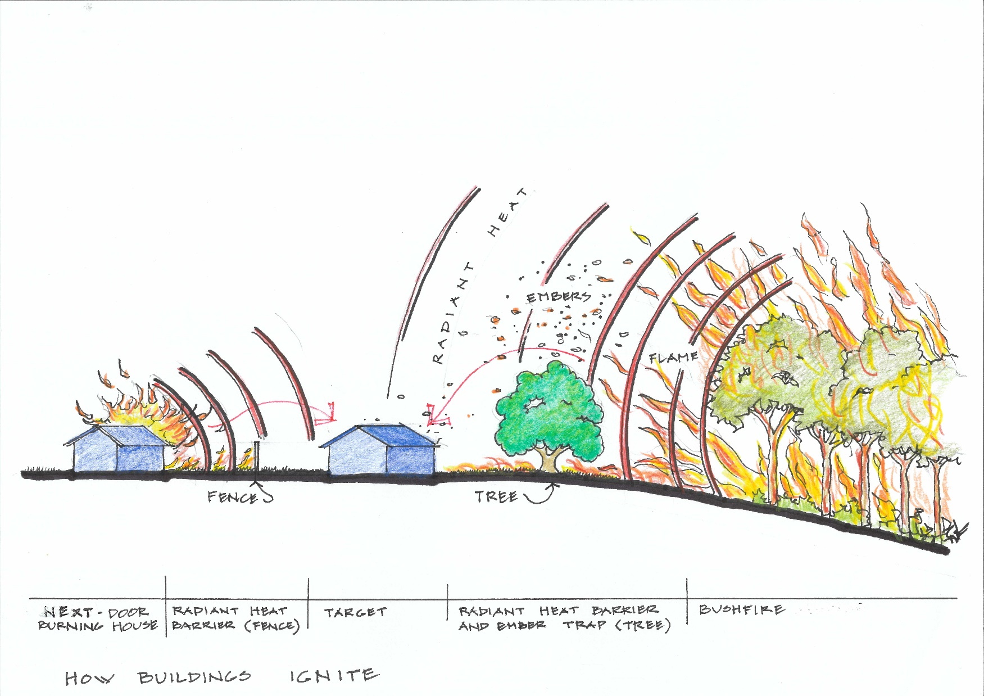
The urban interface scene
Which factors matter to the house that are not local (<500m)?
Arrival likelihood
Fire induced winds

Slide 5
Distance from Home to Occupant Fatality

Slide 6
Concluding Points:
How much risk mitigation will a fuel management treatment have on an Extreme or Code Red Days?
    Local fuel treatment will have an influence on arrival severity at the house.
    To what degree do Broad Landscape fuel treatments influence arrival likelihood and/or fire induced winds in various circumstances?
How can we effectively use these contexts to inform our approaches to fuel management?

