Slide 1
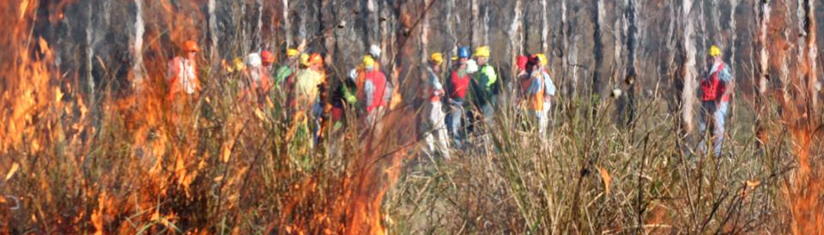
▌Changes in fire season length and planned burn windows
Dr Sarah Harris (Country Fire Authority)
National Fire Fuels Science Webinar 6 May 2020
The thing about hazard reduction: why is it so difficult and divisive?

Slide 2
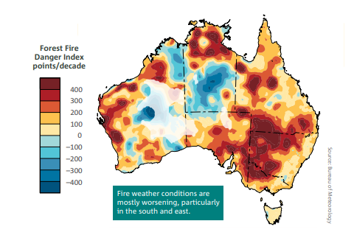
Changes in fire season length and planned burn windows
Presented by: Dr Sarah Harris (Country Fire Authority)
Acknowledgements
Graham Mills, ex Bureau of Meteorology
Tom Duff, University of Melbourne
David Jones, Andrew Dowdy, Lynette Bettio, Bureau of Meteorology
Alen Slijepcevic, Country Fire Authority
Tim Brown, Desert Research Institute
Hamish Clarke, University of Wollongong
Figure 1. Trends from 1978 to 2017 in the annual (July to June) sum of the daily Forest Fire Danger Index—an indicator of the severity of fire weather conditions. Positive trends, shown in the yellow to red colours, are indicative of an increasing length and intensity of the fire weather season. A trend of 300 FFDI points per decade is equivalent to an average trend of 30 FFDI points per year. Areas where there are sparse data coverage such as central parts of Western Australia are faded. (State of the Climate 2018).

Slide 3
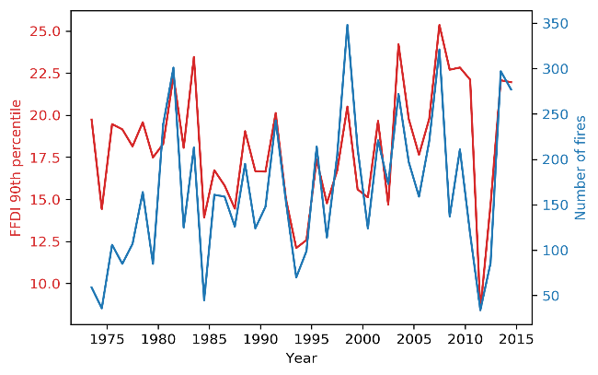
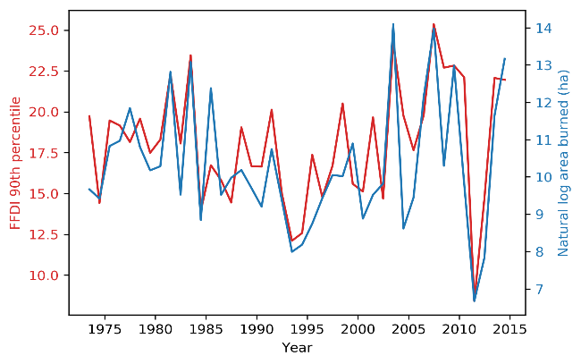
Introduction
Fire season length
Fire season definition varies
Spatial and temporal variation of fire weather
FFDI is linked with fire activity in Victoria
Planned burn windows
Spatial and temporal changes in planned burn windows
Agency defined thresholds
Figure 2. Time series of the annual (July-June) 90th percentile FFDI for Victoria versus Total Number of Fires (TNF) in a, and in b versus natural log of Total Area Burned (TAB, hectares) for the same period 1972/73-2016/17 (Harris et al 2019).

Slide 4
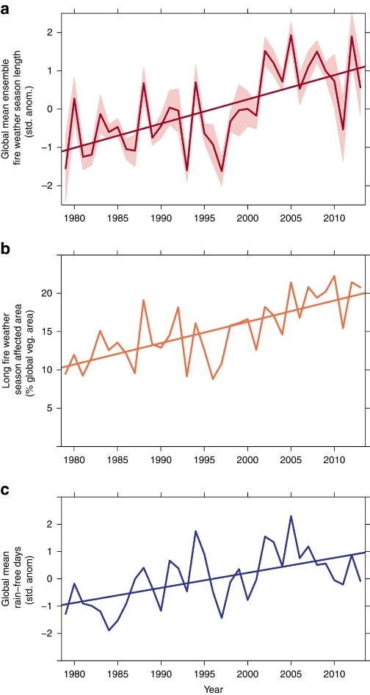
Global and national changes in FFDI timing and extent
Fire weather season increased by 18.7% from 1979 to 2013 (Jolly et al 2015)
Increase in FFDI across Australia with the greatest change occurring in spring and summer particularly in the south east of Australia (Harris and Lucas 2019, Dowdy 2018)
More extreme conditions are projected under climate change (Dowdy et al 2019)
Figure 4. Observed seasonal change in fire weather at 39 stations across Australia (Harris and Lucas 2019)
Figure 3. Changes in global mean fire weather season length from 1979 to 2013 with 95% confidence limits between ensemble members (shaded mean), (Jolly et al 2015)

Slide 5
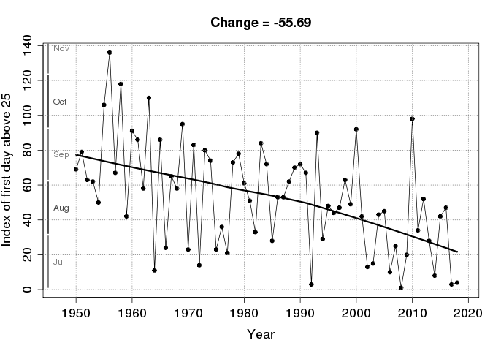
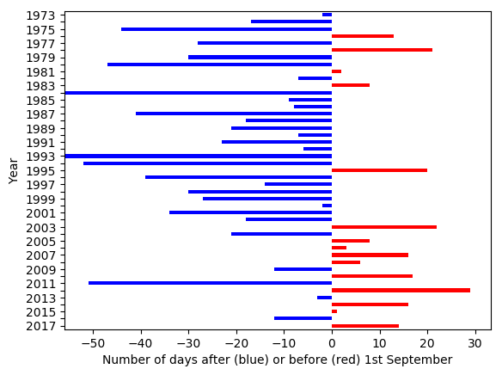
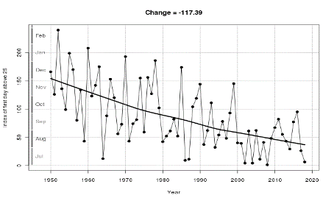
Extent of lengthening fire season
The fire season is more regularly starting early (Harris et al 2019).
Fire season is expanding, with it now typically starting 1-3 months earlier and ending 2-6 weeks later (BoM 2020).
Spatial variability in results.
Figure 6 a. Earliest day above 25 for the fire season starting in July for Victoria (Source: Bureau of Meteorology)
Figure 6b. Earliest day above 25 for the fire season starting in July for south coast NSW (Source: Bureau of Meteorology)
Figure 5.The number of days the first day of the year (Jul-Jun) to reach FFDI> 25 (for 10% of the area) deviates from the fire season start date (1st Sep) (Harris et al 2019)

Slide 6
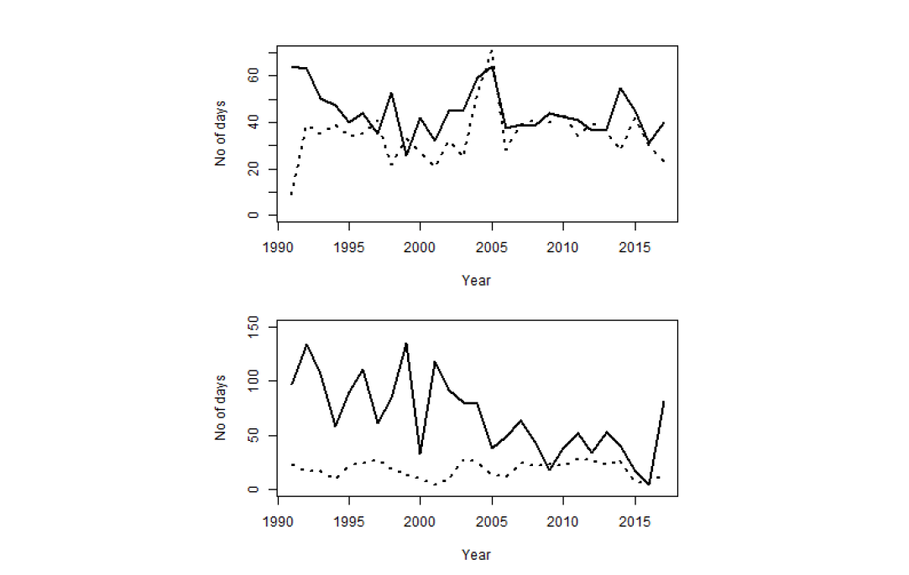
Observed and projected changes in planned burn windows
A complex pattern of projected changes in days available for planned burning (Clarke et al 2019)
Using VIC operational weather thresholds there were very few days available to burn and therefore no trends observed (Duff et al 2020)
The window of completed burns in VIC has reduced in spring (Duff et al 2020)
Further research required to understand the exact constraints for each vegetation type before we can predict changes.
Figure 7 Top) Length of the autumn completed burning period (black), number of days on which burning occurred (dotted black) by year. Bottom) Length of the spring burning window (black), number of days on which burning occurred (dotted black) by year (Duff et al 2020).

Slide 7
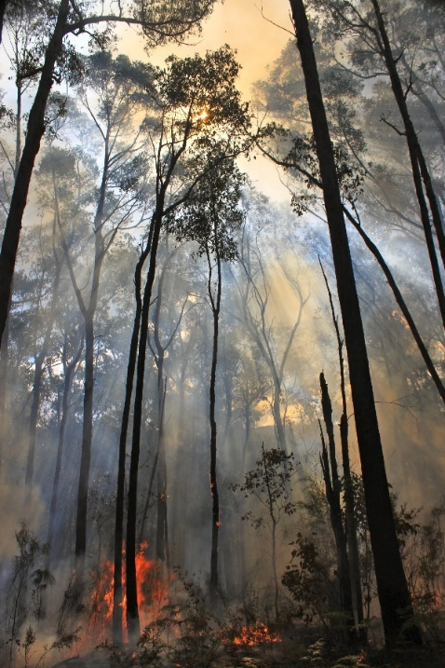
Conclusions
Globally fire weather seasons have lengthened.
FFDI has increased (over the last ~50 years) across parts of Australia and the greatest change has been observed in spring and summer in the south east.
This increase is expected to continue due to climate change.
The fire season (as defined by FFDI>25) is starting earlier in parts of the south east (over the last ~50 years).
Using the VIC operational thresholds there is no trend in burn windows. However, the window of completed burns in VIC has reduced in spring.
Further research is required.
Planned burn in Victoria (Source: Tim Brown)

