Slide 1
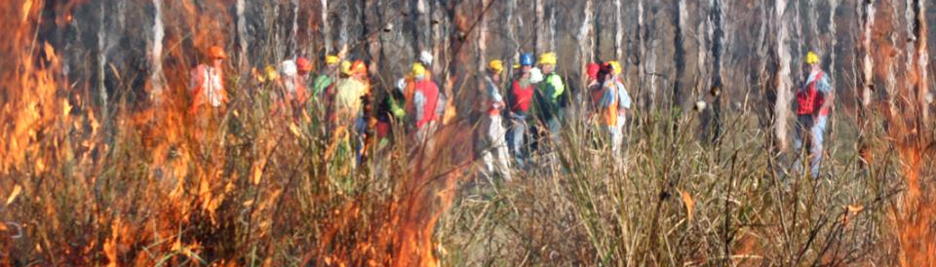
▌Hazard reductions – why so difficult & divisive?
Sascha Rundle, ABC Emergency Broadcasting
National Fire Fuels Science Webinar 6 May 2020
The thing about hazard reduction: why is it so difficult and divisive?

Slide 2
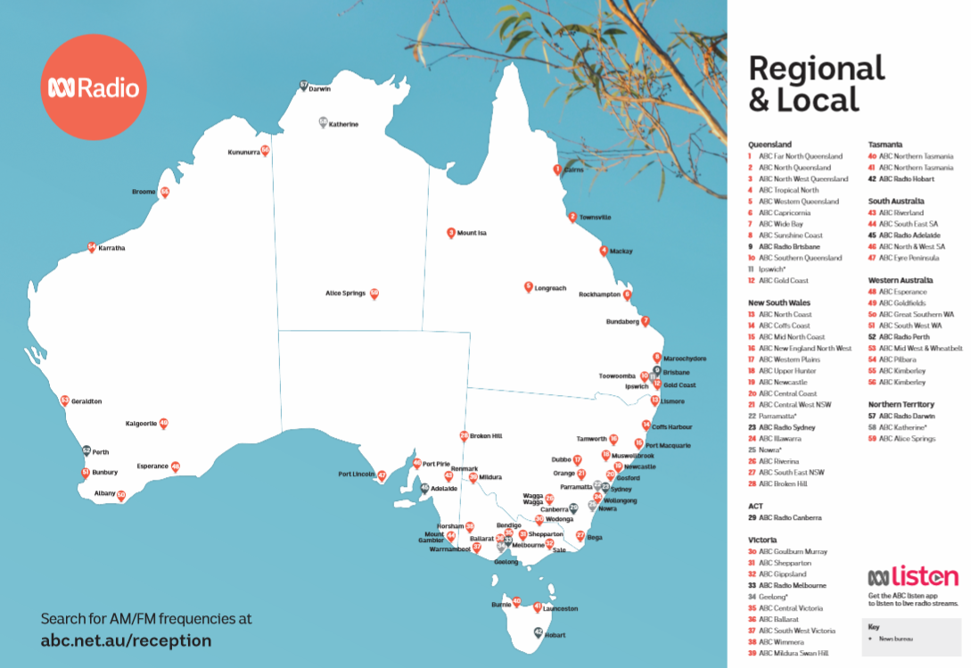
ABC emergency broadcasting helps the public:
prepare for
respond to
recover from
emergency events.
Notes:
Many Australians engage with ABC content of some kind
85 % Aust believe the ABC provides quality content / 80% of Aust believe the ABC provides distinctive content
Many Aust turn to the ABC in times of emergency, due to our reach as a broadcaster
In July this year we surveyed people across Aust on their awareness of the ABC as an emergency broadcaster. 98% of respondents told us they knew the ABC broadcast emergency warnings & info and they rated it 9/10

Slide 3
Hazard reductions keep people safe from bushfires
There’ll be more fires if we have fewer controlled burns
We want more of them
Areas that miss out will burn next season
Houses burn when hazard reductions don’t happen in time
We need more firies & forestry staff to do more hazard reductions
Hazard reductions maintain the landscape
Farmers should be able to do more burns
Bushfires run hotter if there hasn’t been a controlled burn
A range of views
(for)

Slide 4
They’re bad for our health (asthma)
Burning everything makes this beautiful area less attractive
They add to our greenhouse emissions & pollution
Too many hazard reductions get out of control
Some are done on days when it’s not safe
We should just let nature take its course
The burns kill too many animals
If you remove too much debris the area dries out
The line between arson & controlled burning is indistinct
Broadscale burning is not the (only) solution
Fuel reduction burns & logging make forests more flammable
A range of views
(against)

Slide 5
My view is better / stronger / smarter than your view
Indigenous fire practises are better
Too many cutbacks (NPWS, forestry) & red tape
Smaller window for controlled burns
Too many govts ignore fire experts
Open up the forests more and use tracks as fire breaks
It is / isn’t the fault of the ‘greenies’
More non-fire fuel reduction is needed
Let the cattle roam / graze free
Local councils should control the burns
Properties neighbouring national parks / forestry are at risk
Need better strategies of where to burn
A range of views
(other)

Slide 6
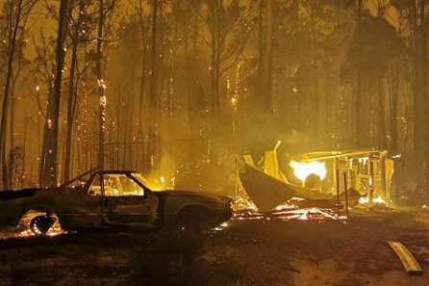
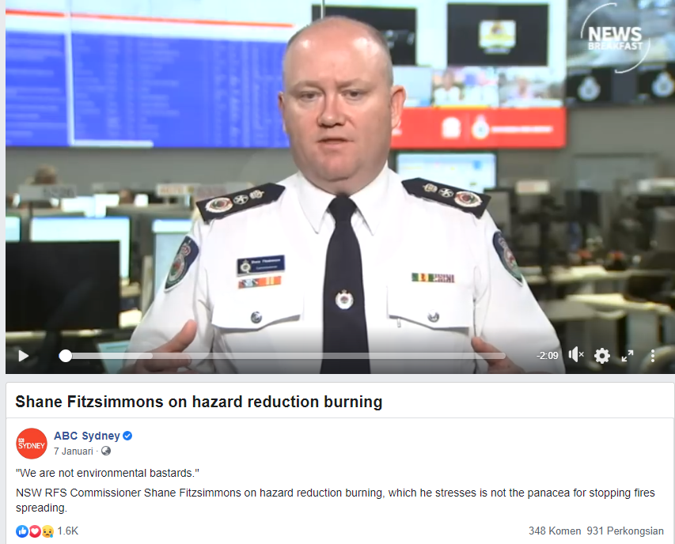
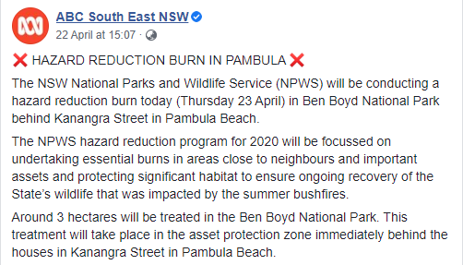
Opinions are becoming more passionate
Gippsland fires 31 Dec 2019
Notes:
Discuss how we’re seeing an increase in emergency broadcast events from year to year
There is a HUGE increase in this current season in EB events … mainly thanks to the fire risk

Slide 7
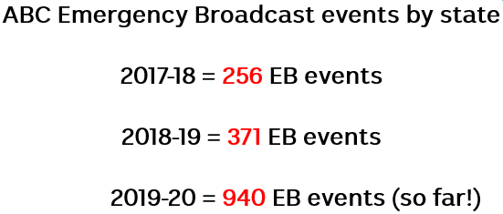
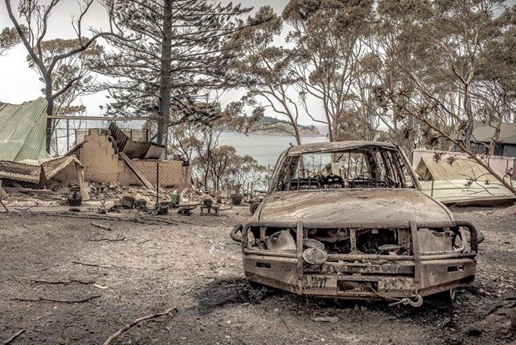
Why this forum is so important

