Slide 1

NSW RFS efforts in science and future opportunities and the Australian Fire Danger Rating system
Stuart Matthews
NSW Rural Fire Service

Slide 2
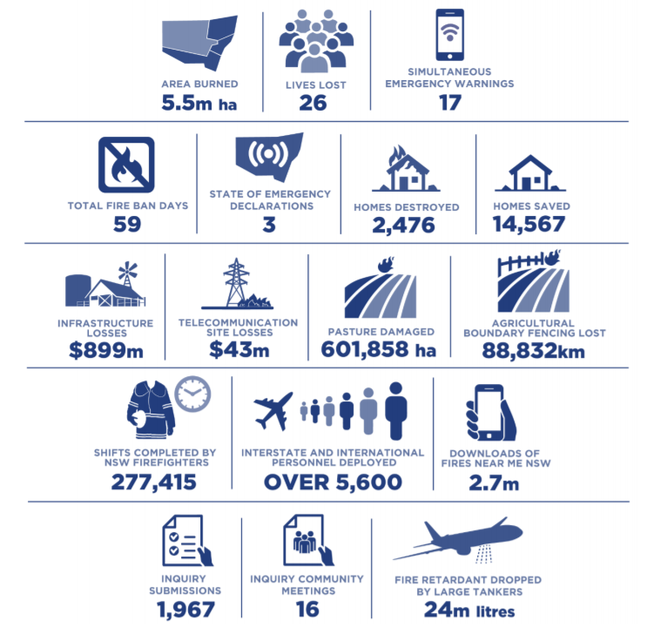
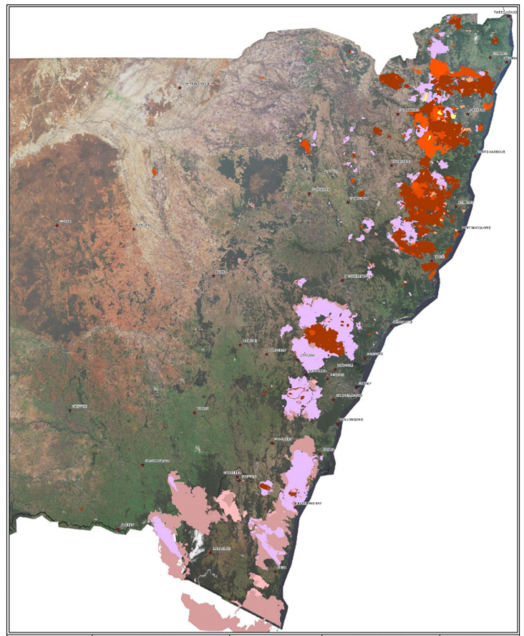
NSW 2019-20 Fire season
https://www.dpc.nsw.gov.au/assets/dpc-nsw-gov-au/publications/NSW-Bushfire-Inquiry-1630/Final-Report-of-the-NSW-Bushfire-Inquiry.pdf

Slide 3
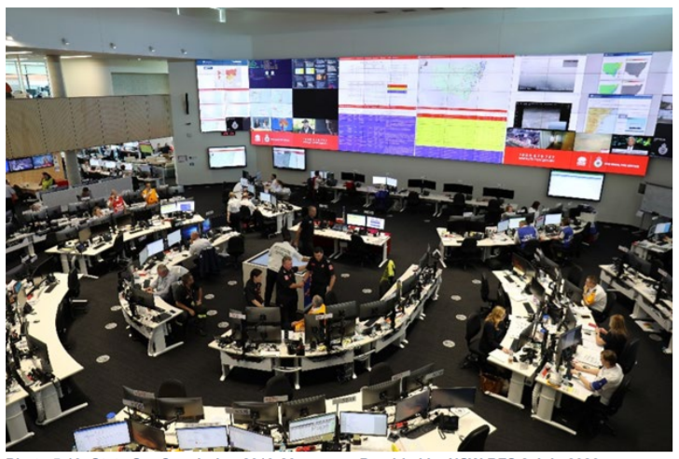
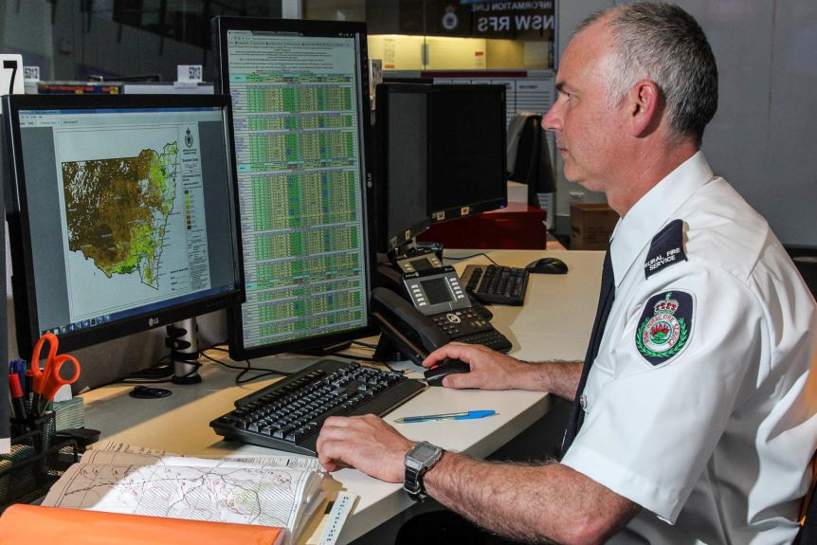
Fire behaviour predictions
https://www.abc.net.au/news/2017-11-02/what-it-takes-to-be-a-fire-analyst-with-the-rfs/9109262

Slide 4
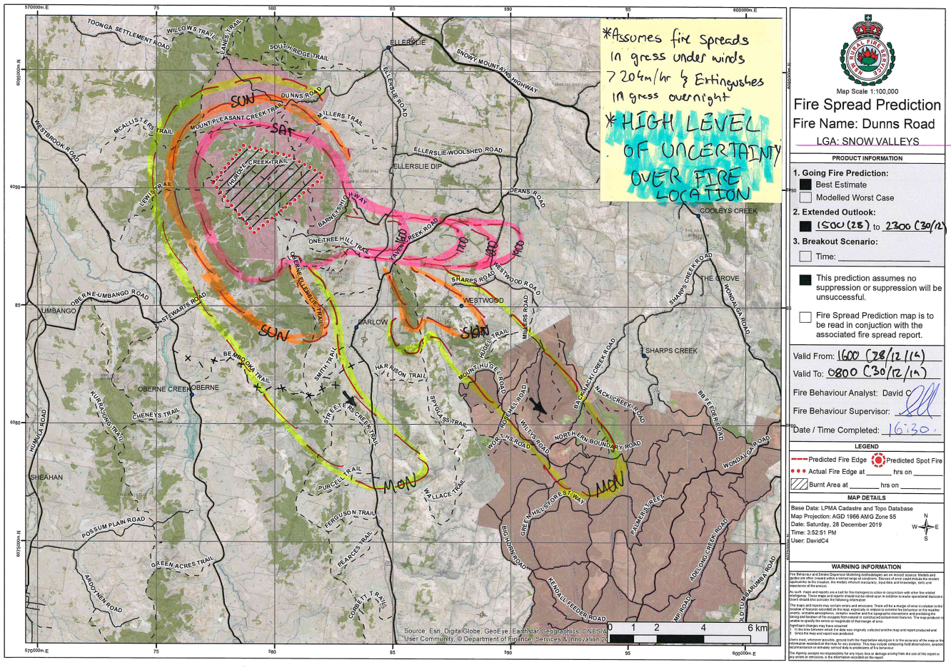
Fire behaviour predictions

Slide 5
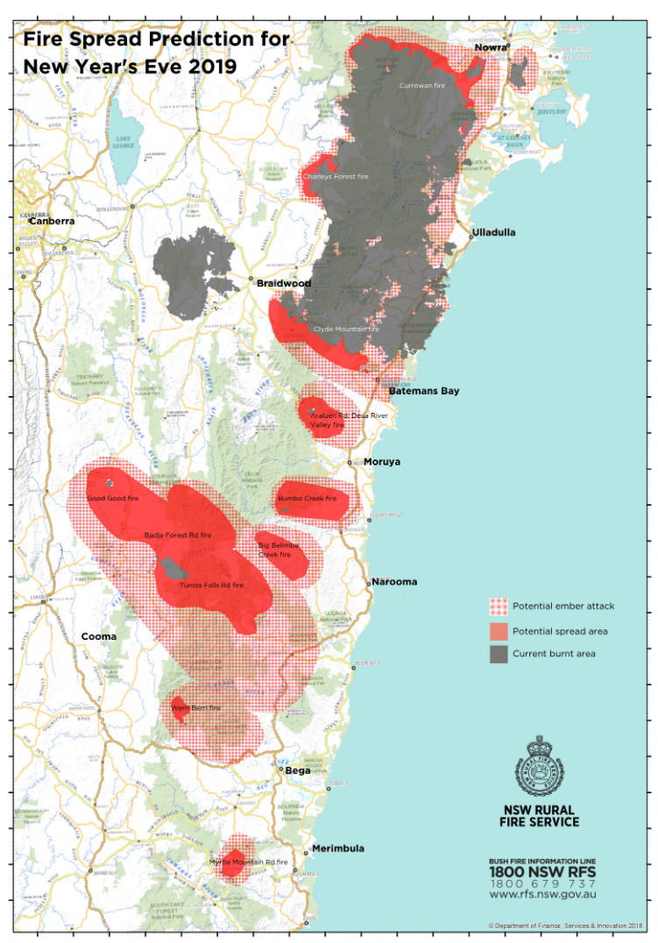
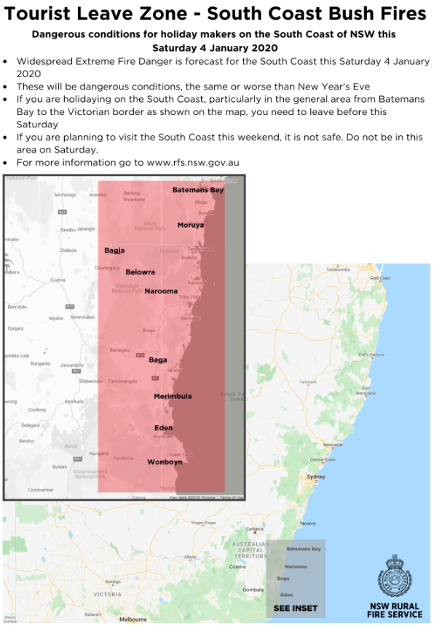
Sharing predictions with the public
https://twitter.com/NSWRFS

Slide 6
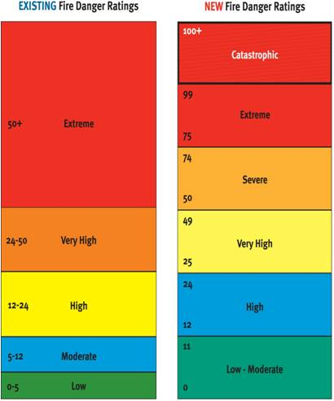
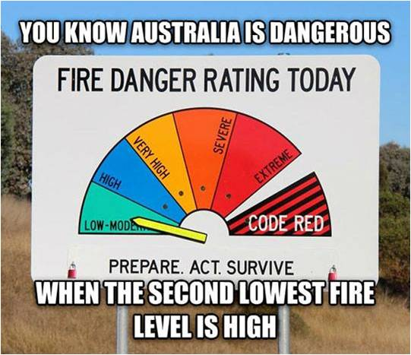
Fire danger ratings
Black Saturday 2009
FDR Working Group formed
New FDR categories introduced
Review of grass thresholds

Slide 7
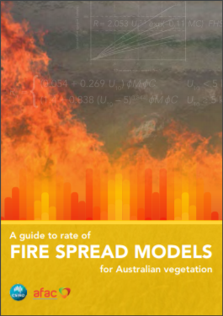
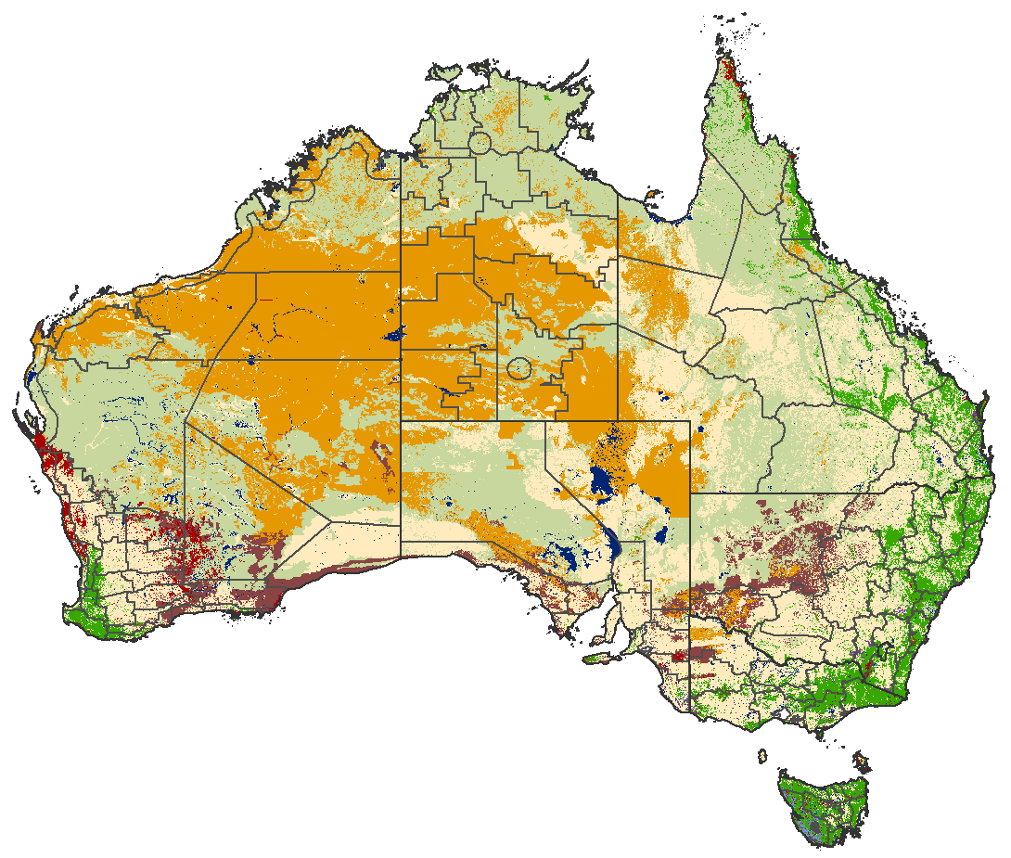
Fire behaviour models
  Forest: Vesta/DEFFM (Cheney et al. 2012)
  Grassland: CSIRO (1998) grassland with Cruz et al. (2015) curing
  Savanna/woodland: CSIRO (1998) ‘northern’ grassland
  Buttongrass: Marsden-Smedley and Catchpole (1995)
  Shrubland: Anderson et al. (2015)
  Mallee-heath: Cruz et al. (2013)
  Spinifex: Burrows (2017 update)
  Pine: Customised Cruz et al. (2011)
Notes:
And so, by incorporating new fire spread models, we were able to consider a whole new range of fuel types
I’ve listed all the models there for anyone that is interested, but if you are,
I can also recommend getting your hands on the book by Cruz and Co at the top right, which provides a really good foundations for the background, uses and applications of the various models too….
So we were able to do this at a national scale

Slide 8
FDR Category Definitions
Typical Consequences
Veg Type FDR Category Tables
Mostly self-extinguishing, trouble-free fires
Typical prescribed burning conditions, fires generally easy to suppress.
Most wildfires in this category. Fires typically suppressed with direct, parallel or indirect attack.
Initial attack success critical to prevent large fire development. Defensive suppression strategies.
Defensive suppression strategies. High levels of threat to life/property. Safety of fire fighters and community paramount.
Unsafe for fire fighters and community. Without initial attack success, likelihood of very large fire development is very high. High probability of loss of life and property.

Slide 9
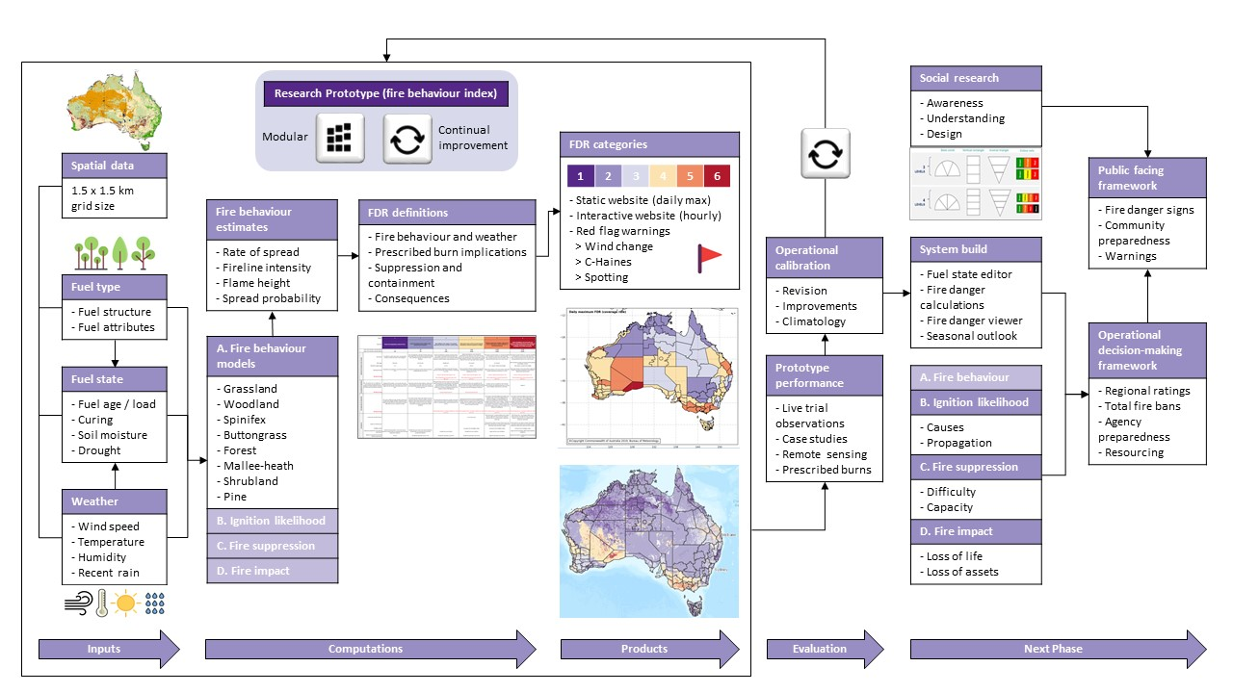
Notes:
A big part of what I’ve been involved in over the few years has working out:
How we group and categorise fire danger
And what each of the categories mean.

Slide 10
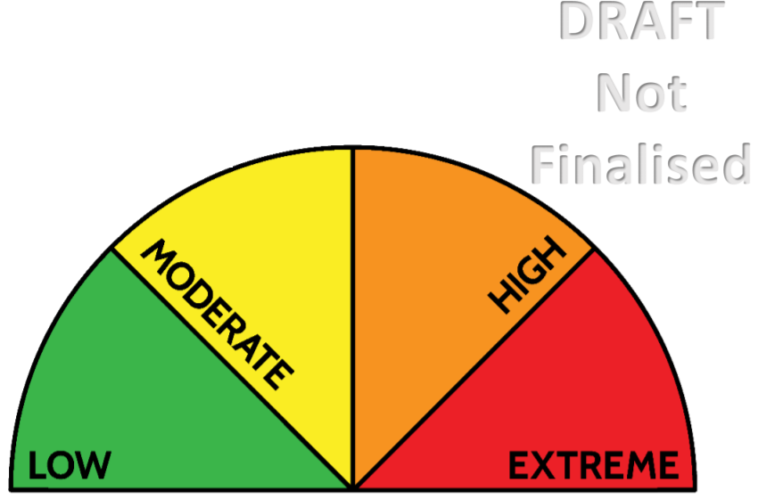
Simpler messages for the public
Optimised and simplified version of the existing system
4 Levels
Green, Yellow, Orange, Red
Low, Medium, High, Extreme
Include supportive messaging
Clear, concise and action orientated
Details to be confirmed
Fire behavior index as well

