Slide 1
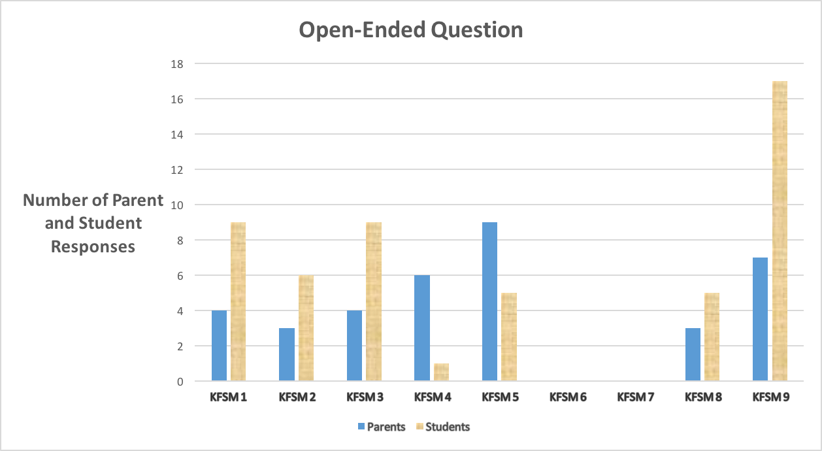
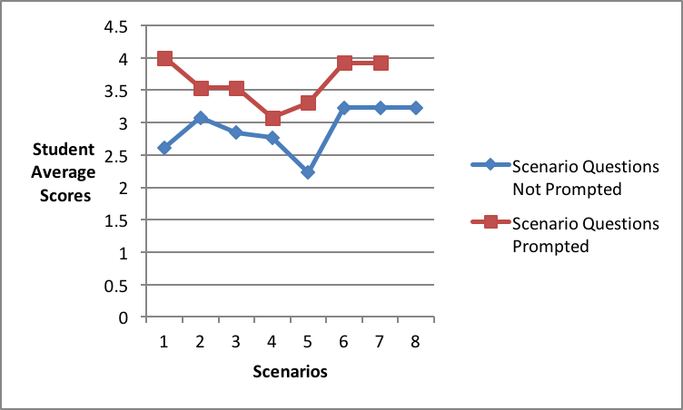




Tasmania Fire Service
School Fire Education Program
Retention of Key Fire Safety Messages
Clarke, A.¹ , Ronan, K.¹ , Reaburn, R. ² , Towers, B. ³
¹ School of Human, Health and Social Sciences, CQUniversity, Rockhampton, Queensland
² School of Mathematics and Geospatial Science, RMIT, Melbourne, Victoria
³ School of Education, University of Tasmania, Launceston, Tasmania
This study investigated the retention of Key Fire Safety Messages (KFSM) by students and their parents following exposure to the Tasmania Fire Service (TFS), School Fire Education Program (SFEP). The sample group for this study consisted of thirteen students and their parents from Northern Tasmania. The students were interviewed using a number of open-ended and scenario based questions, whilst the parent group completed a short survey. Two of the findings from the study are presented below. Findings from this study have also provided a foundation for extension in a number of ways through upcoming PhD research, including experimental evaluation of performance-based learning and retention of KFSM's.
Key Fire Safety Messages
This study focused on the eight KFSM which appear on the TFS School Fire Education website. http://www.tfseducation.com.au
As noted below a ninth category was necessary to cover other KFSM taught throughout the program (e.g. Spot the Hazard at Home), but not appearing on the website.
All KFSM from the website were determined as Primary KFSM and those that did not were considered to be Secondary KFSM and were examined as one group.
KFSM 1 = Crawl low and go, go, go to the nearest exit
KFSM 2 = Two metres from the heater/fire
KFSM 3 = Stop, Drop, Rock n Roll
KFSM 4 = Smoke Alarms Save Lives
KFSM 5 = Plan and Practice to escape
KFSM 6 = A match/lighter is a tool for adults
KFSM 7 = Cooking, turn it off before you turn away
KFSM 8 = If a fire starts in your home there are four rules
KFSM 9 = Secondary Key Fire Safety Messages
Student & Parent Open-Ended Question Responses
The participants were asked the same open-ended question as part of their structured interview.
The question asked ’What can you tell me about about home fire safety?’
When posed to students this question elicited a total of 54 responses which could be linked back to either Primary or Secondary KFSM.
When posed to parents this question elicited a total of 36 responses which could be linked back to either Primary or Secondary KFSM.
It is interesting to note that the students’ retention of KFSM relating to their own self preservation was generally higher than messages aimed at protecting other family members. When this same question was asked of parents the opposite was true with parents recalling more KFSM that potentially protected the family. The responses for both parents and students are shown in Figure 1
The students were asked a second question with regards to ‘What is the most important message about home fire safety?’ It was interesting to note that a Secondary not Primary KFSM relating to the dangers of electricity and fire was perceived by the students as the most important message.
Scenario Questions
Students were asked a series of eight scenario questions which replicated the application of Primary KFSM. They were first asked the scenario without prompting and were then asked a second time with five prompted responses. The exception was Scenario 8, which asked the students to apply four rules to escape a house fire. This question could not be prompted.
Responses were coded using a partial credit model and provided further insight into students retention of KFSM. Student responses were scored from 4 (verbatim recall) to 0 (no recall ). Figure 2 shows the student averages for the scenarios.
As expected the students’ responses improved when prompted. This may indicate that emergency situations may serve as a type of prompting increasing actual levels of retention.
Future Direction
A PhD investigating the impacts of stress on retention and the real world application of KFSM is now underway . This PhD will present an experimental evaluation of performance-based learning. This PhD forms part of the larger BNHCRC project ‘Child-Centred Disaster Risk Reduction.’
Figure 1
Figure 2
© BUSHFIRE AND NATURAL HAZARDS CRC 2015

