Slide 1


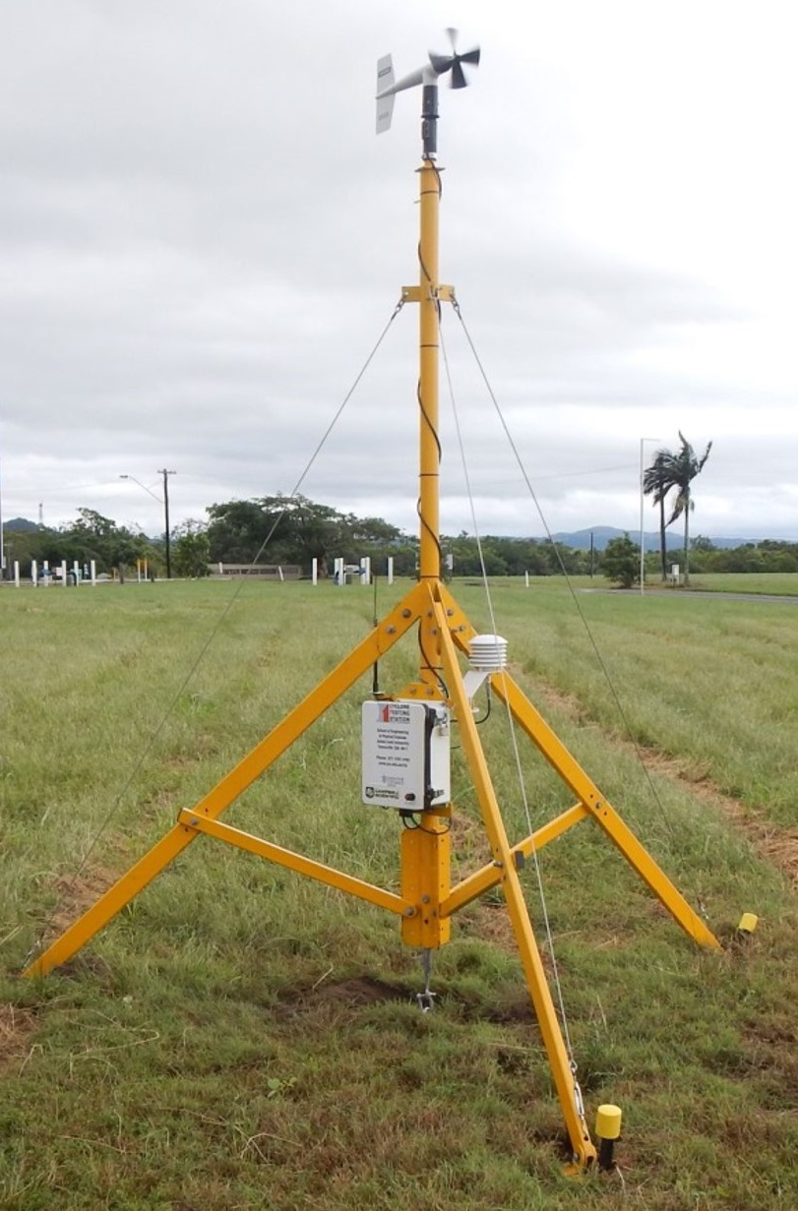

Real-time tropical cyclone data for impact – Part 2
Matthew Mason
The University of Queensland
Thanks to Saira Viqar, Pat Driscoll, Korah Parackal, Geoff Boughton
© Natural Hazards Research Australia 2023
Notes:
DESIGN INSTRUCTIONS:
Add text to editable text boxes.
Avoid moving or changing the margins for text boxes, to ensure a well-presented slide.
To add a colour to the cut-out shape/background:
To fill cut-out shape/background with colour, right click next to the slide and select ‘Format Background…’ from the drop-down menu.
In the side panel that pops up, select ‘Solid fill’ and then choose one of the ‘Theme colors’ at the top of the colour chart.
Note: the ‘Theme colors’ are NHRA corporate colours and should be used wherever possible.
To add an image to the cut-out shape/background:
click on the image icon to select an image source
once you’ve added an image, right click the image and select ‘Send to Back’ so that it sits behind the cut-out shape

Slide 2
NHRA SWIRLnet project
Streamlining SWIRLnet data acquisition, analysis, storage and dissemination procedures
Aims
  Automate back-end tower information entry and analysis
  Improve real-time data access
  Incorporate new instrumentation into the network
  Build a repository for archiving measured data

Slide 3
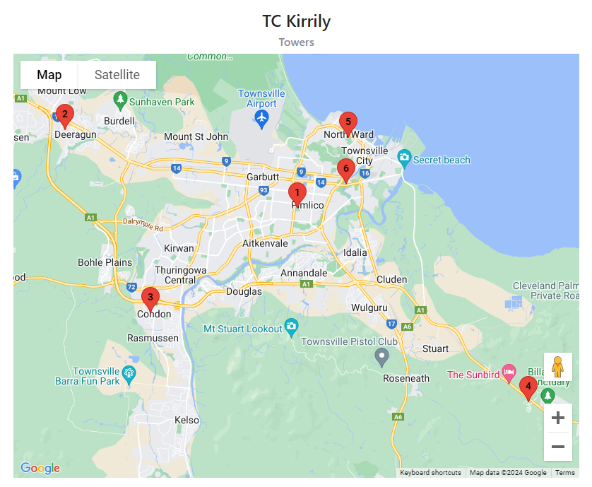
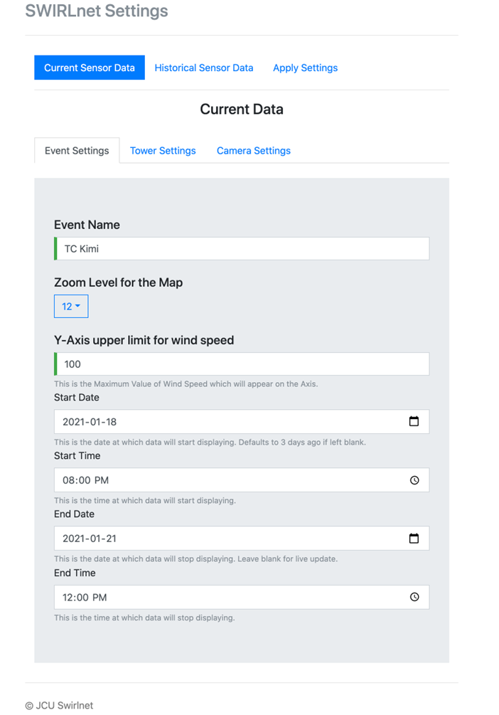
SWIRLnet – back-end
Back-end (existing)
  Analysis coding in MATLAB (on Matt’s laptop)
  Manual data download/analysis
  Single user access to update website
Back-end (updated)
  Analysis coding converted from MATLAB to Python
  Automated data syncing and analysis (allows real-time reporting)
  Web interface developed for entry of tower/storm information for website

Slide 4
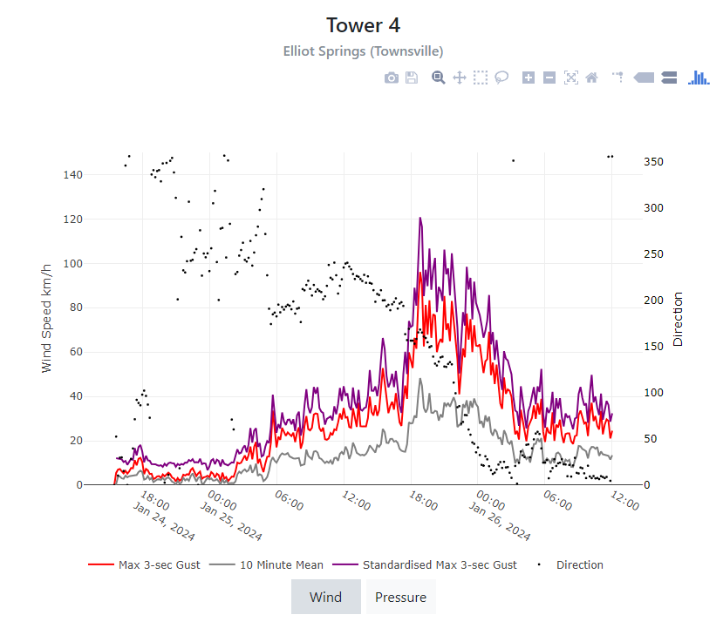
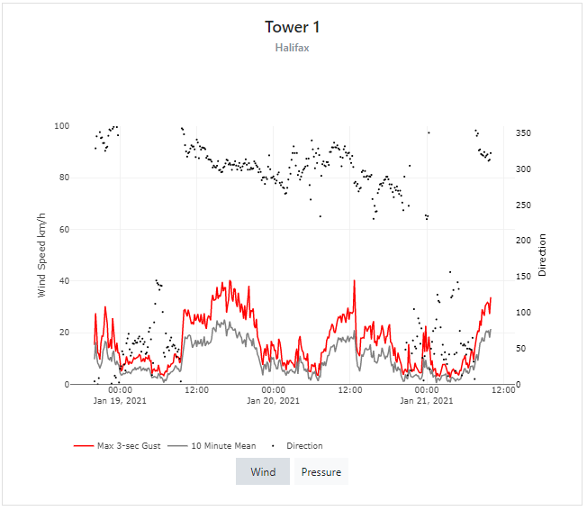
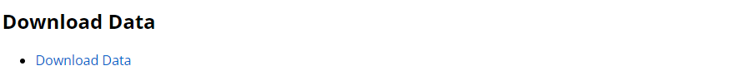
SWIRLnet – real-time access
Converted data for comparison with BOM AWS
Real-time data (existing)
  Public
    Access through website
    Approximate tower locations
    Raw observation data plots
  End-users
    Access through Dropbox
    Exact tower location and site imagery
    Raw and converted data files
Real-time data (updated)
  Single data access point through website
  Raw and converted data plots for all
  Data download function
https://www.jcu.edu.au/swirlnet/wind-speed-data

Slide 5
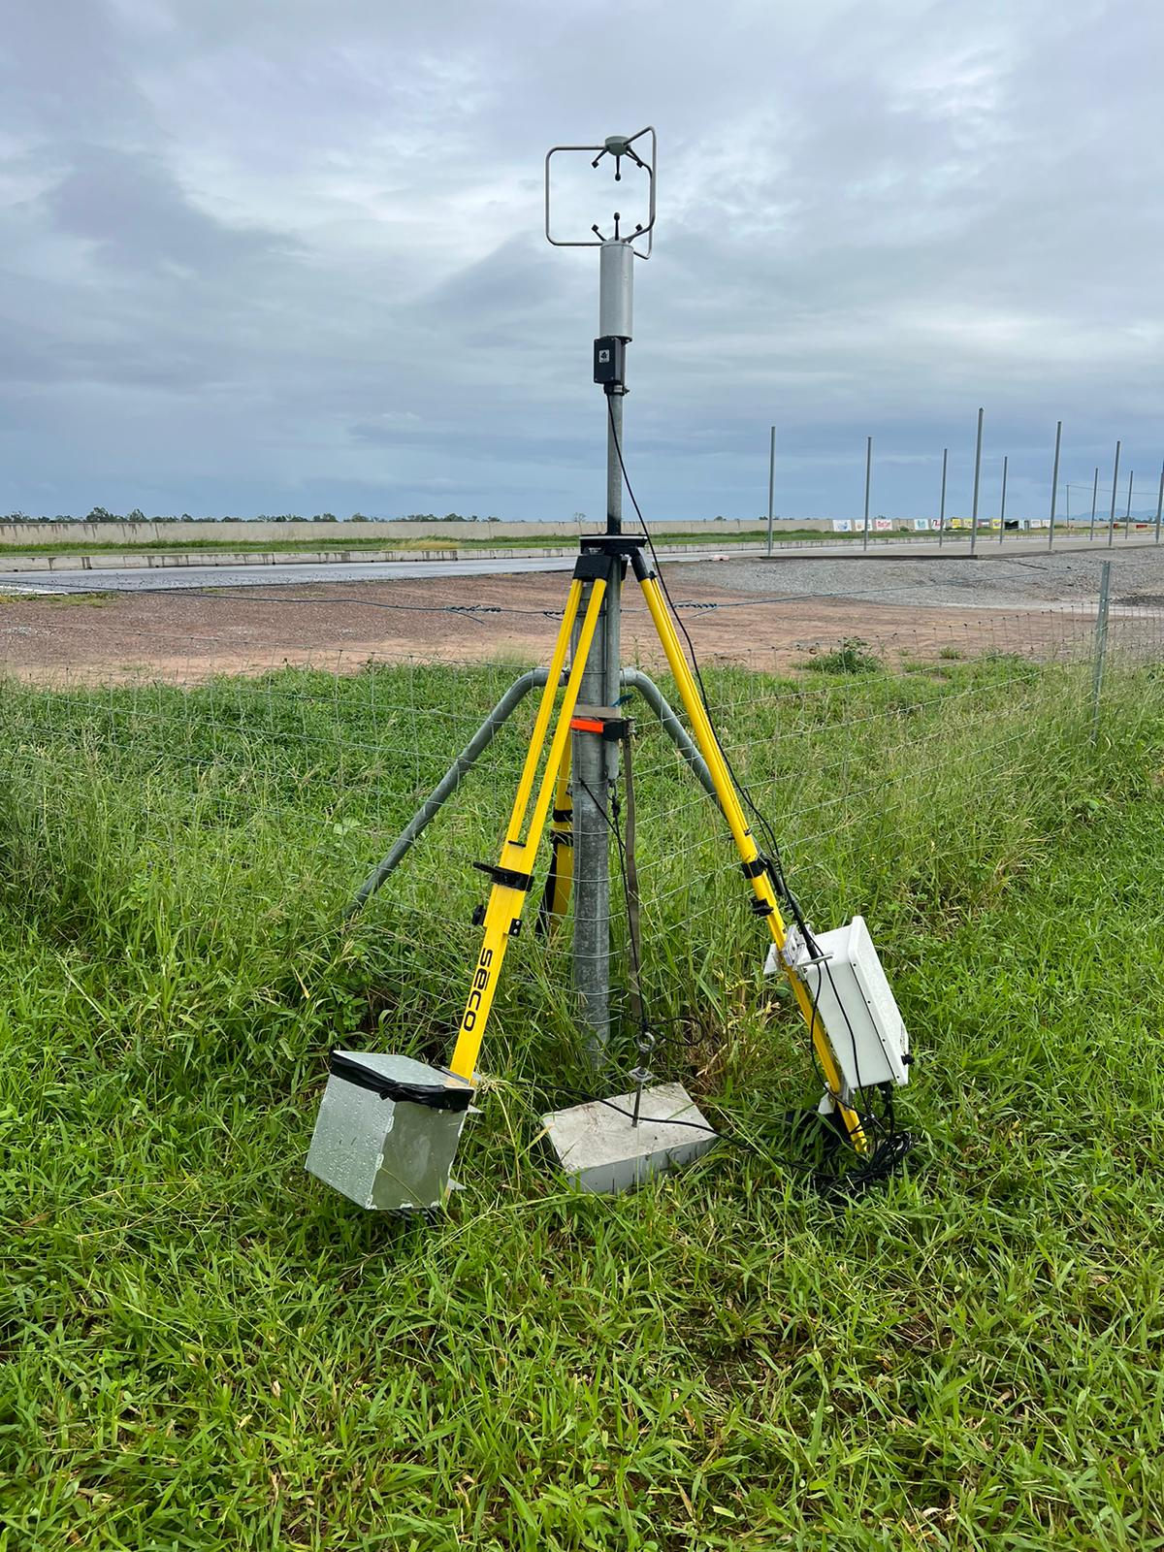
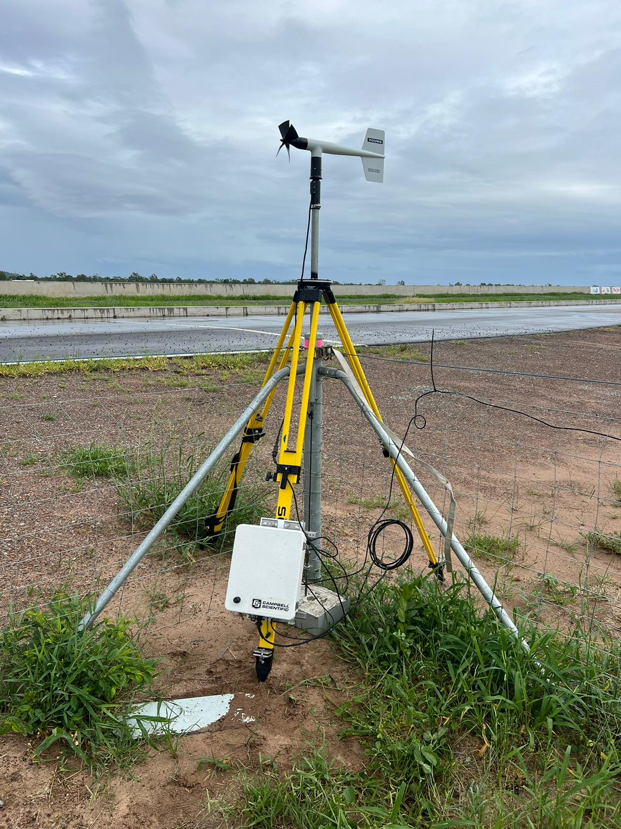
SWIRLnet - instrumentation
6 rapidly deployable 3.2 m towers
Marine RM Young anemometers, RH, pressure and temperature sensors, and video imagery
Logged locally (10Hz) with 10-min summary data transmission
Central anchors, foot anchors, guy wires
3 new towers tested (2D sonic, 3D sonic, RM Young) trialled during TC Kirrily

Slide 6
SWIRLnet - repository
Open access (and on-going) repository for archiving measured data
  JCU Research Data
  Searchable through Research Data Australia
  Includes for each event
    Information sheet (storm overview, tower locations)
    QC’d 10 Hz wind speed and direction data at each tower
    QC’d 10-min meteorological data at each tower
Eight deployments since 2014
  2013/14: TC Dylan, TC Ita
  2014/15: TC Nathan
  2016/17: TC Debbie
  2018/19: TC Owen
  2020/21: TC Kimi
  2023/34: TC Jasper
  2023/24: TC Kirrily
Under development

Slide 7
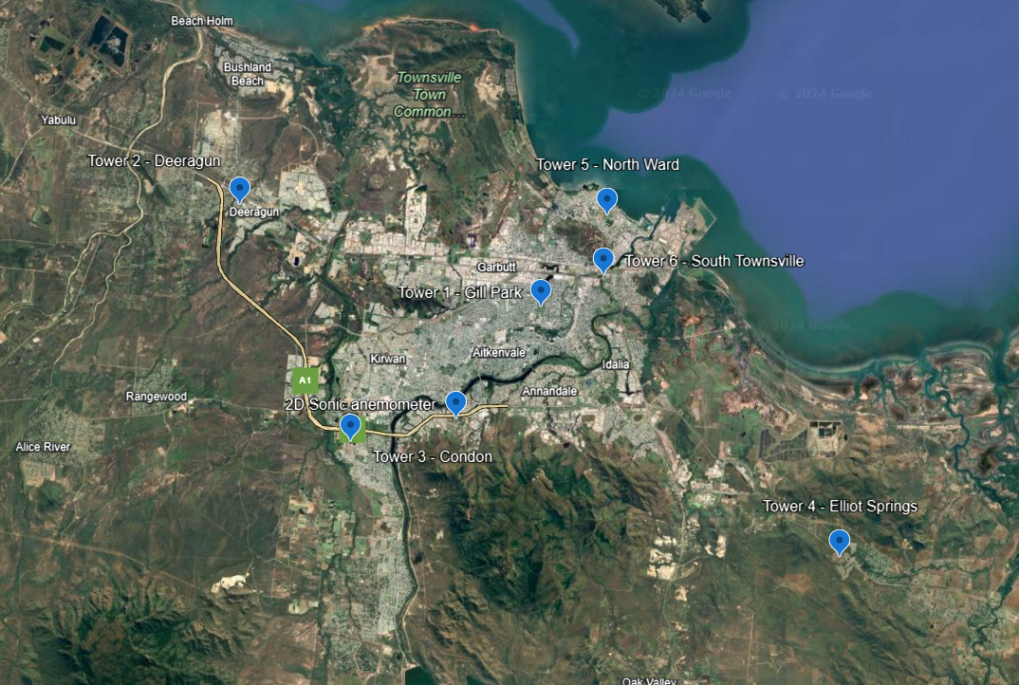
Observations of interest (TC Kirrily)
66.2 km/h
(85.2 km/h)
63.9 km/h
(81.3 km/h)
67.2 km/h
(88.8 km/h)
40-55% V₅₀₀
68.4 km/h
(90.9 km/h)
Peak 3-sec gusts
96.1 km/h
(120.8 km/h)
Maximum 3-sec gusts

Slide 8
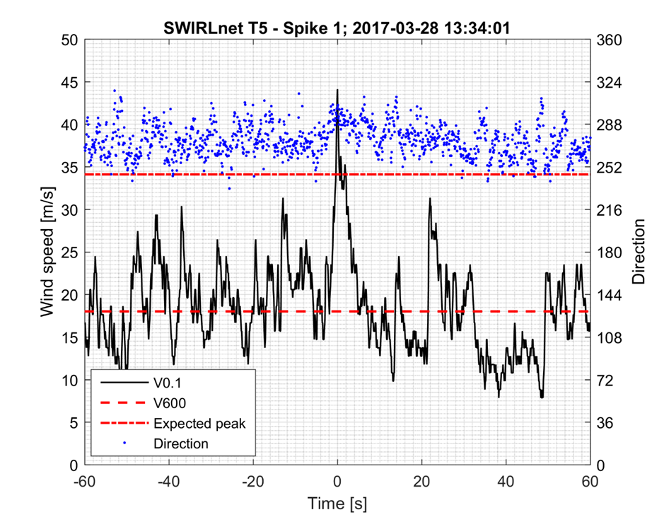
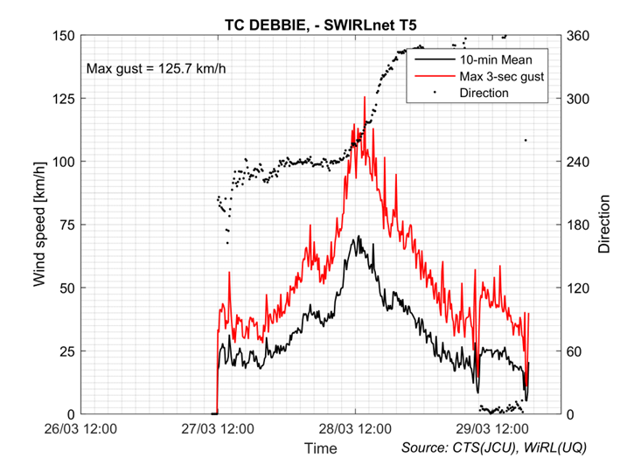
Observations of interest (TC Debbie)
25% greater than theory suggests
Expected max gust value

Slide 9
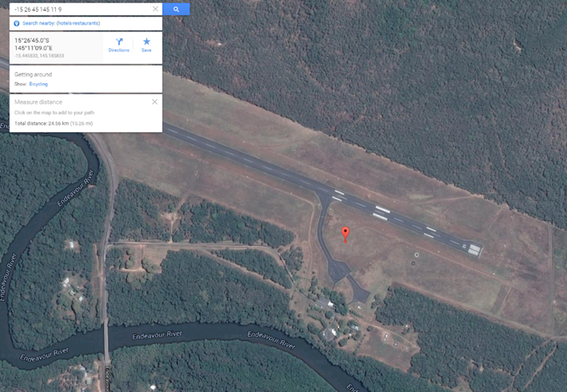
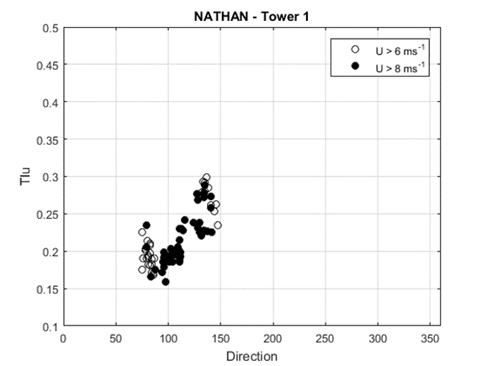
Observations of interest (TC Nathan)
250 m
1000 m
250 m
1000 m

Slide 10
Real-time tropical cyclone data for impact – Part 3
Francesca Kirby
Australian Reinsurance Pool Corporation
© Natural Hazards Research Australia 2023
Notes:
DESIGN INSTRUCTIONS:
Add text to editable text boxes.
Avoid moving or changing the margins for text boxes, to ensure a well-presented slide.
To add a colour to the cut-out shape/background:
To fill cut-out shape/background with colour, right click next to the slide and select ‘Format Background…’ from the drop-down menu.
In the side panel that pops up, select ‘Solid fill’ and then choose one of the ‘Theme colors’ at the top of the colour chart.
Note: the ‘Theme colors’ are NHRA corporate colours and should be used wherever possible.
To add an image to the cut-out shape/background:
click on the image icon to select an image source
once you’ve added an image, right click the image and select ‘Send to Back’ so that it sits behind the cut-out shape

Slide 11
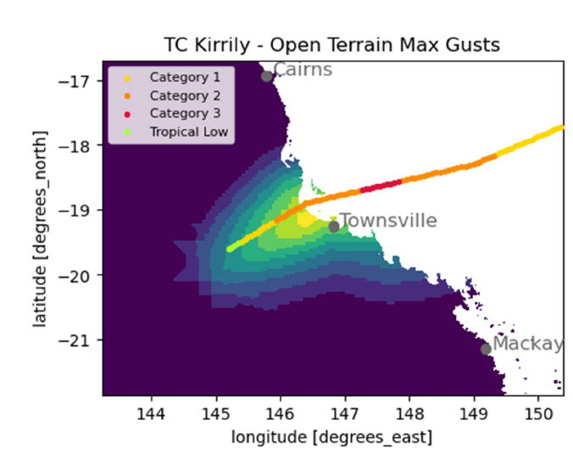
Producing loss estimates
Cyclone pool
Aims to improve insurance affordability
Covers all losses caused by TCs declared by BoM
Covered cyclone events
Losses must be estimated following an event
Risk Frontiers estimates losses using reanalysis wind speed data
Wind field simulations are validated using SWIRLnet data
Source: Risk Frontiers TC Kirrily Early Loss Estimate Report

Slide 12
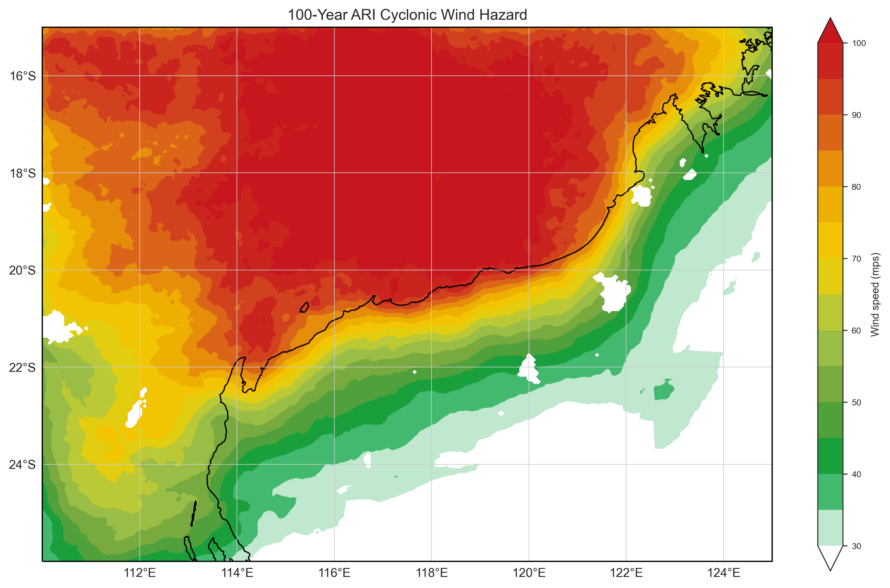
Claims analytics
Cyclone pool premiums vary depending on building characteristics
Claims data can validate our view on how vulnerable different materials are at different wind speeds
Claims costs are matched to wind speeds using wind field simulations
Wind field simulations are validated using SWIRLnet data
Source: Geosciences Australia

